Slide 1
Mission partners in 44 countries
45 missionaries (and counting!)
Prospective mission fields in 18 new countries…
Give thanks to the Lord!
WELS WORLD MISSIONS
Notes:
WELS World Missions conducts gospel outreach in 44 countries and is exploring outreach opportunities in 18 prospective new mission fields. World Missions brings the light of God’s Word to the world through evangelism efforts, church planting, training national workers for ministry, and providing religious materials in foreign languages through Multi-Language Productions (MLP). 45 world missionaries partner with over 400 national pastors to conduct outreach and train more than 380 students for service in Christ’s kingdom.
World Mission supports mission work:
on Native American reservations, where the gospel has been shared on the Apache reservations in Arizona for more than 125 years and exploratory mission work is beginning on other reservations throughout North America;
in Africa, where missionaries partner with national church bodies in six countries and are exploring outreach in at least seven more countries throughout the continent;
in Asia, where the two missionary teams have joined together to equip, encourage, and empower others to bring the good news of Jesus Christ to 1.8 billion unreached souls;
in Latin America, where hundreds of thousands of people are being reached through Academia Cristo online courses and more than 40 individuals are being trained to plant a church;
in Europe, where missionaries partner with national churches to train the next generation of church leaders and bring the true gospel to countries without a strong Lutheran presence;
and through Multi-Language Productions, which has produced materials in more than 56 languages and reaches tens of thousands of English-speakers in more than 30 different countries through the TELL online training platform.

Slide 2
Notes:
The Board for World Missions (BWM) has four main functions:
Reach out to those who have not heard about Jesus yet.
Reach out to church bodies who contact us asking for help.
Mentor and train pastors and leaders to be confessional Lutherans.
Support this work in many languages through the production of materials such as videos, literature, publications, websites, advertising, and gospel tools through Multi-Language Productions.

Slide 3
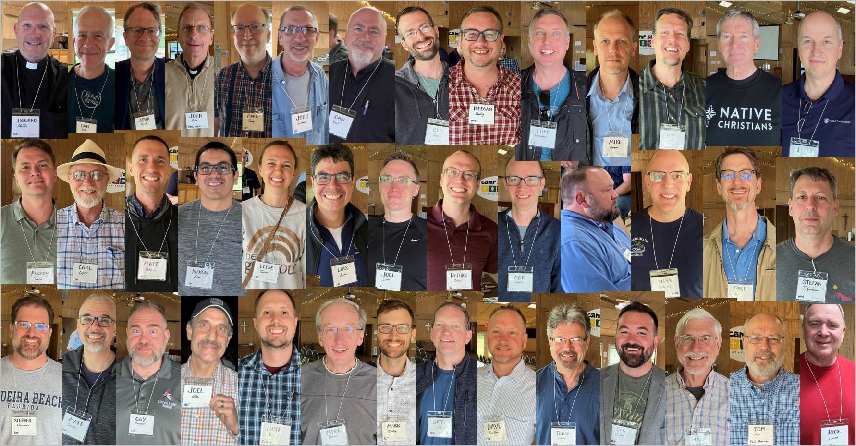
World Missionary Conference – April 2022
Notes:
From April 19-23, 41 world missionaries, board members, and other supporters of World Missions gathered at Camp Shiloh in Pittsburg, Tex., for a world missionary conference.
This conference allows for much-needed fellowship and encouragement, and it also provides a forum to share best practices and valuable professional growth opportunities. Each field presented on the gospel outreach occurring in their corner of the world, and selected speakers presented on topics like leveraging technology for lasting gospel relationships and how to be spiritually, emotionally, and physically resilient missionaries.

Slide 4
Notes:
The Europe mission team partners to share Christ’s grace in Albania, Bulgaria, London and the U.K., Portugal, Russia, and Ukraine while supporting sister church bodies in seven additional European countries. Currently there are two WELS missionaries residing in Europe.

Slide 5
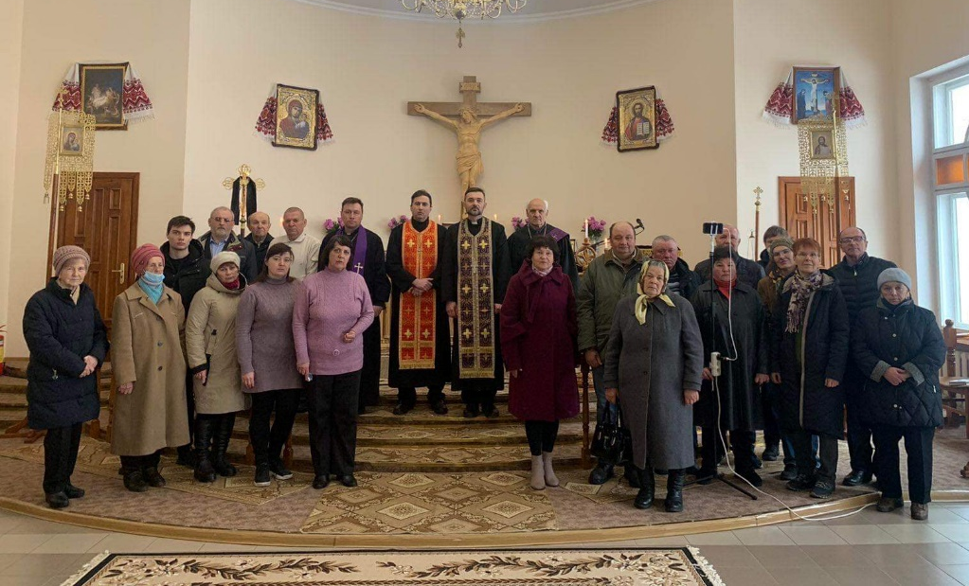
Notes:
WELS members are giving generously to help relieve the suffering in Ukraine from the war. These gifts provide aid to and through members of the Ukrainian Lutheran Church (ULC), WELS’ sister church in Ukraine.
WELS World Missions and WELS Christian Aid and Relief have sent some of these donations to Direct Relief, an organization that is able to provide immediate medical aid and supplies where they are needed most, including to help refugees in Poland. Gifts have also been sent to the Ukrainian Lutheran Church. Most of these gifts are sent directly to pastors or churches who help people buy food, heating fuel, gasoline, medications, and basic needs. In some areas, prices of certain essential products and food have nearly quadrupled. While these gifts do help ULC members, they are also used to help any who they are able to help. Many people need aid, and our churches try to meet these needs as best they can.
WELS communicates regularly with the leadership from the Ukrainian Lutheran Church and provides updates on how the war is affecting the members in Ukraine. Most ULC congregations continue to hold worship, either in person or online, proclaiming the hope they have in Jesus. The church body’s bishop was even able to offer a brief devotion on National Radio that included reading John 3:16.
Visit wels.net/ukraine for additional updates as they become available.

Slide 6
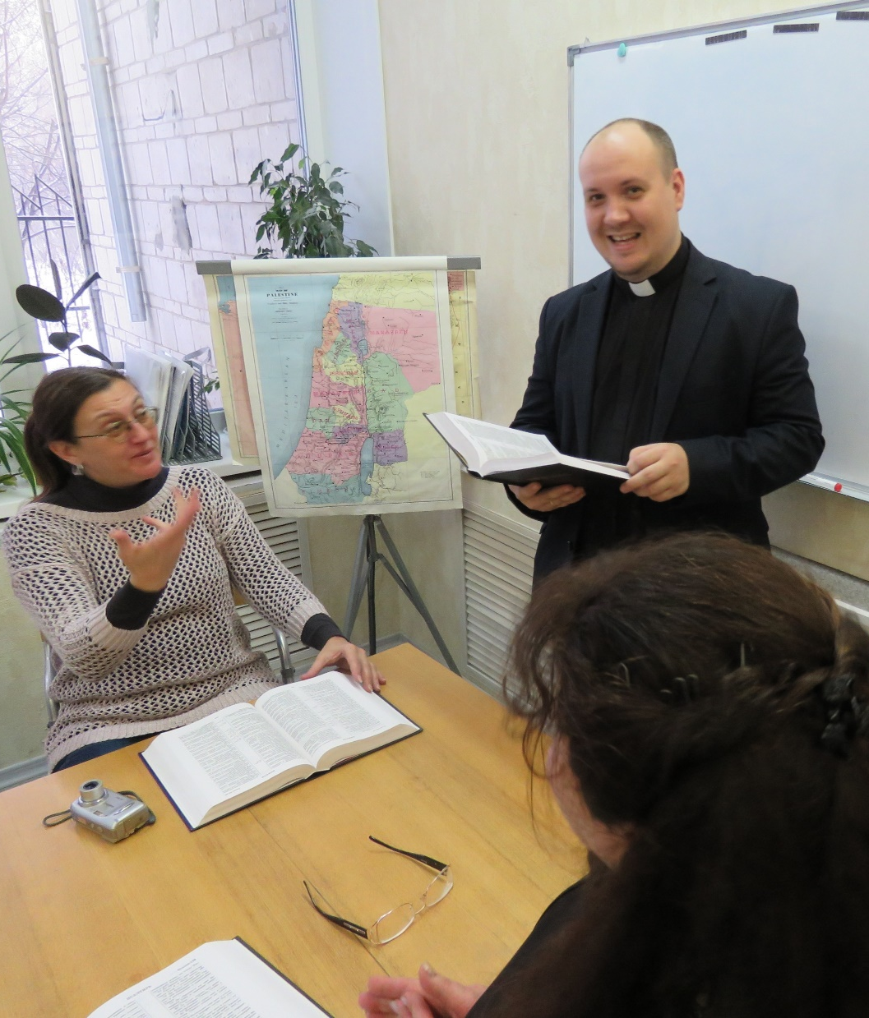
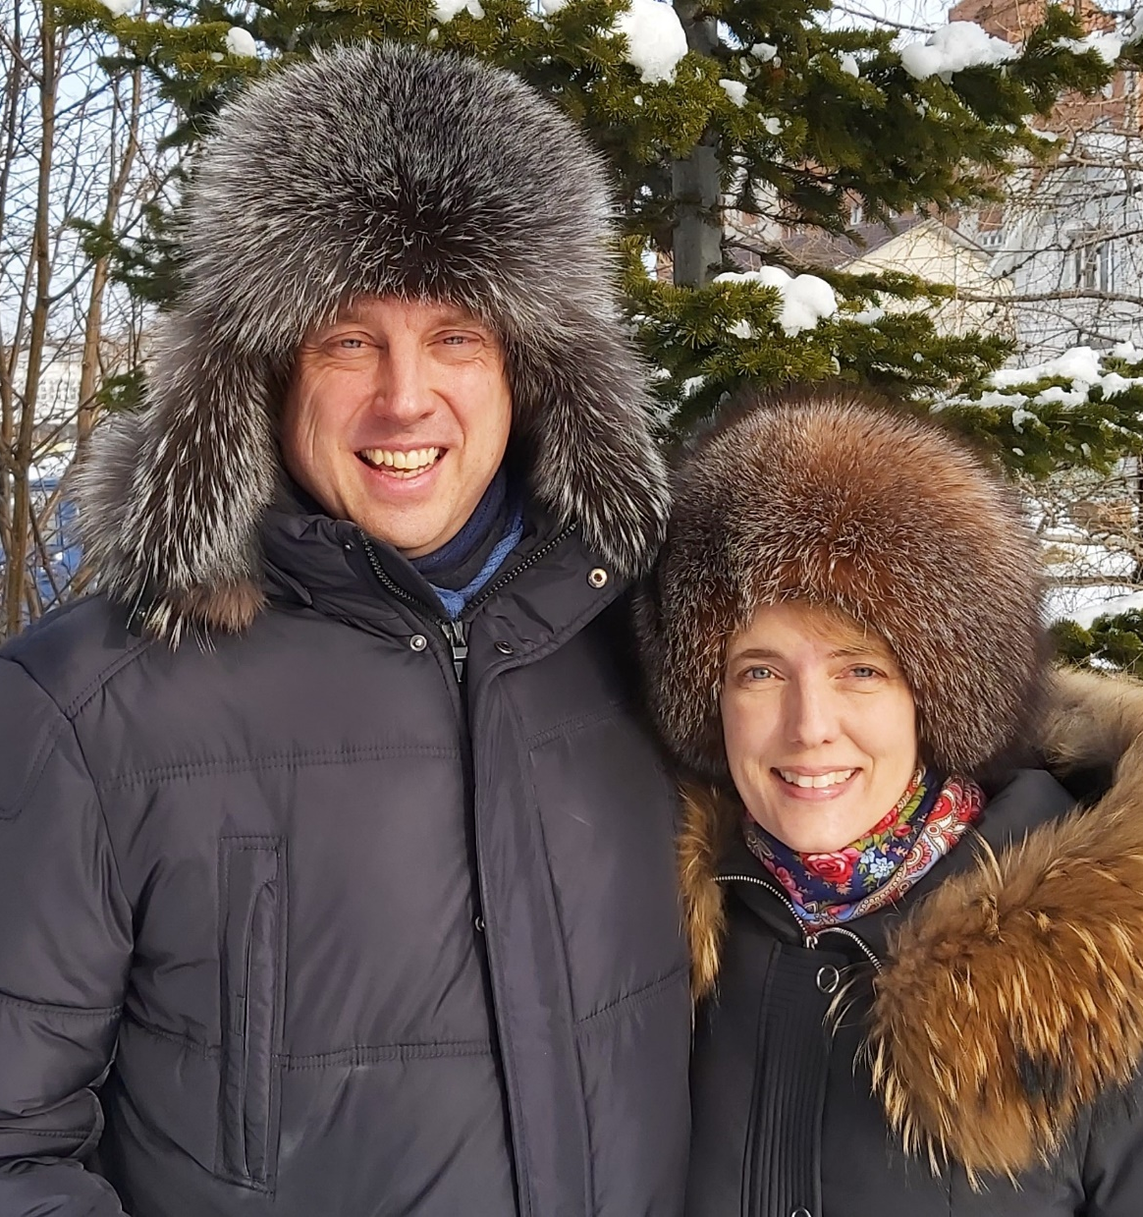
Russia
Notes:
Missionary Luke Wolfgramm and his wife, Jennifer, left Russia and traveled to Albania on March 1, four days after Russia invaded Ukraine. The Wolfgramms have lived and served in Russia for the past 25 years.
In the four days after the invasion, Wolfgramm met with church leaders and preached at several of the congregations. He offered encouragement and hope, but also last-minute instructions to church leaders about the practicalities of managing the church’s business affairs. He had been working with church leaders for several months already, starting to prepare them for when the Wolfgramms planned to leave the country in 2024. He partners in ministry with a dozen sister churches in Europe, helping with training seminary students, leading workshops, mentoring, and preaching. The church in Russia will continue to be one of the churches he partners with, just not as a resident missionary.
For the short term, the Wolfgramms are living in Durres, Albania, helping train a seminary student there. As of March 31, they still are able to keep in touch with the three Russian pastors and one seminary student who are leading the 270-member church body. Pastor Alexei from Russia (pictured left) shares, “We’re in good hands. We’re in God’s hands, and that’s the best place to be.” They definitely see that this is God at work to speed up the timetable to give them opportunities to share Jesus’ peace in a world that desperately needs it.
WELS will continue to support the Russian church as it is able to under current sanctions. Our prayers go out for the church members there that their connection to their Savior through the means of grace stays strong as God leads us to a new stage of fellowship.

Slide 7
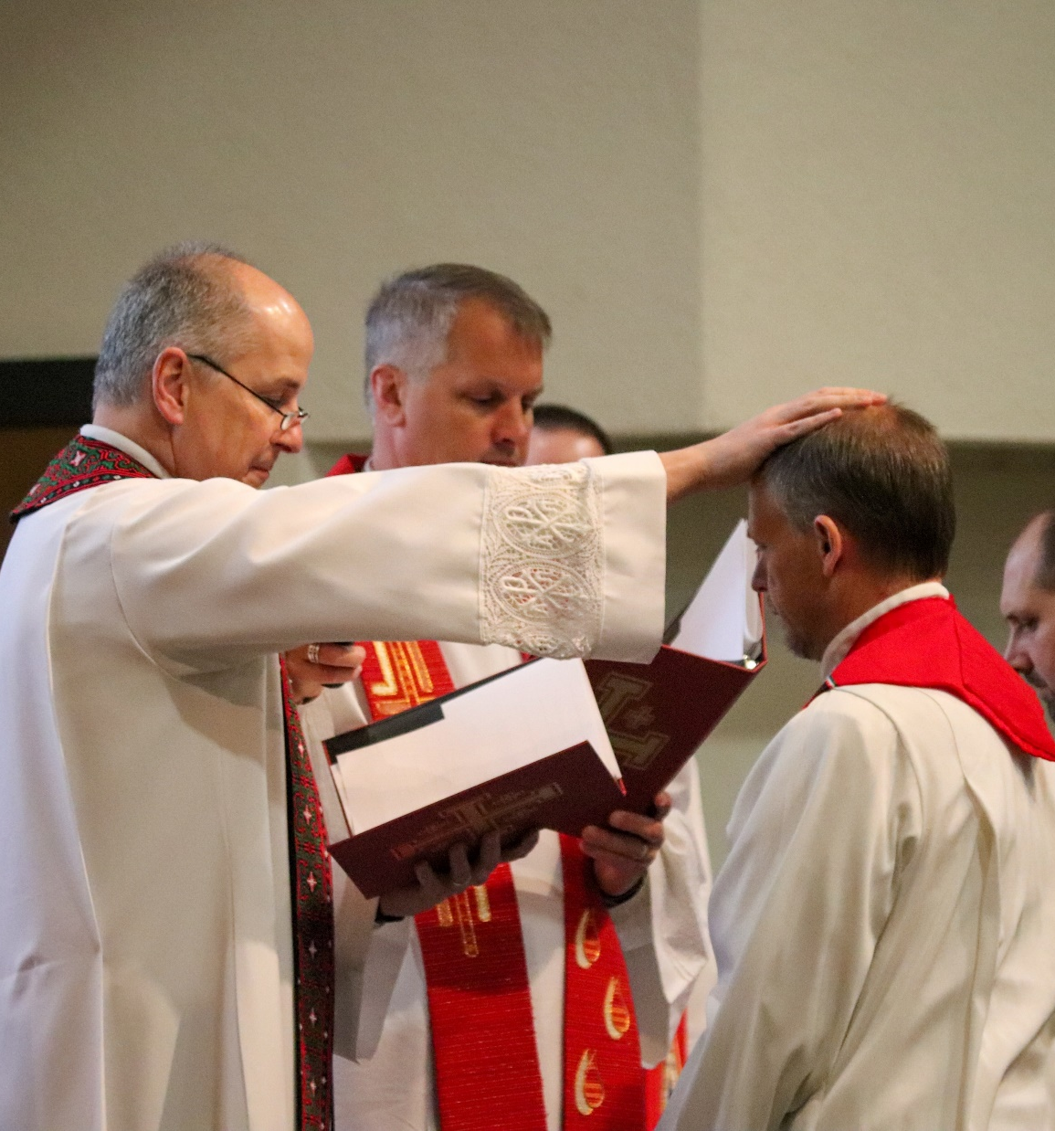
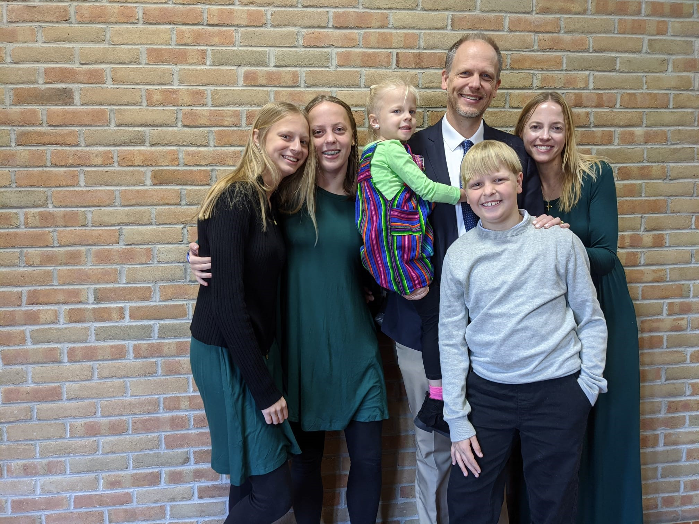
London
Notes:
In February, Pastor Michael Hartman was commissioned as our WELS missionary to London at Wisconsin Lutheran Seminary’s student-led Mission and Ministry seminar. The next day a WELS planning team went on a visit to London. One of the outcomes of the visit was a plan to guide Hartman’s initial work. World Missions will be looking to work with dedicated, generous, outreach-minded Christians (“Priscilla and Aquila” types) who gather friends and neighbors around the Word.
Rev. Conifer Berg was assigned from Wisconsin Lutheran Seminary as a second missionary to London and the U.K. on May 26, 2022. Missionary Berg will join Missionary Michael Hartman to begin serving a group already gathering in London, connect with contacts from other sister church bodies, and launch outreach efforts. With the Lord’s blessing, it is the prayer this mission work could provide a springboard for further in the U.K., made up of England, Wales, Scotland, and Northern Ireland, and the entire continent of Europe.
Stay updated on progress at wels.net/london.

Slide 8
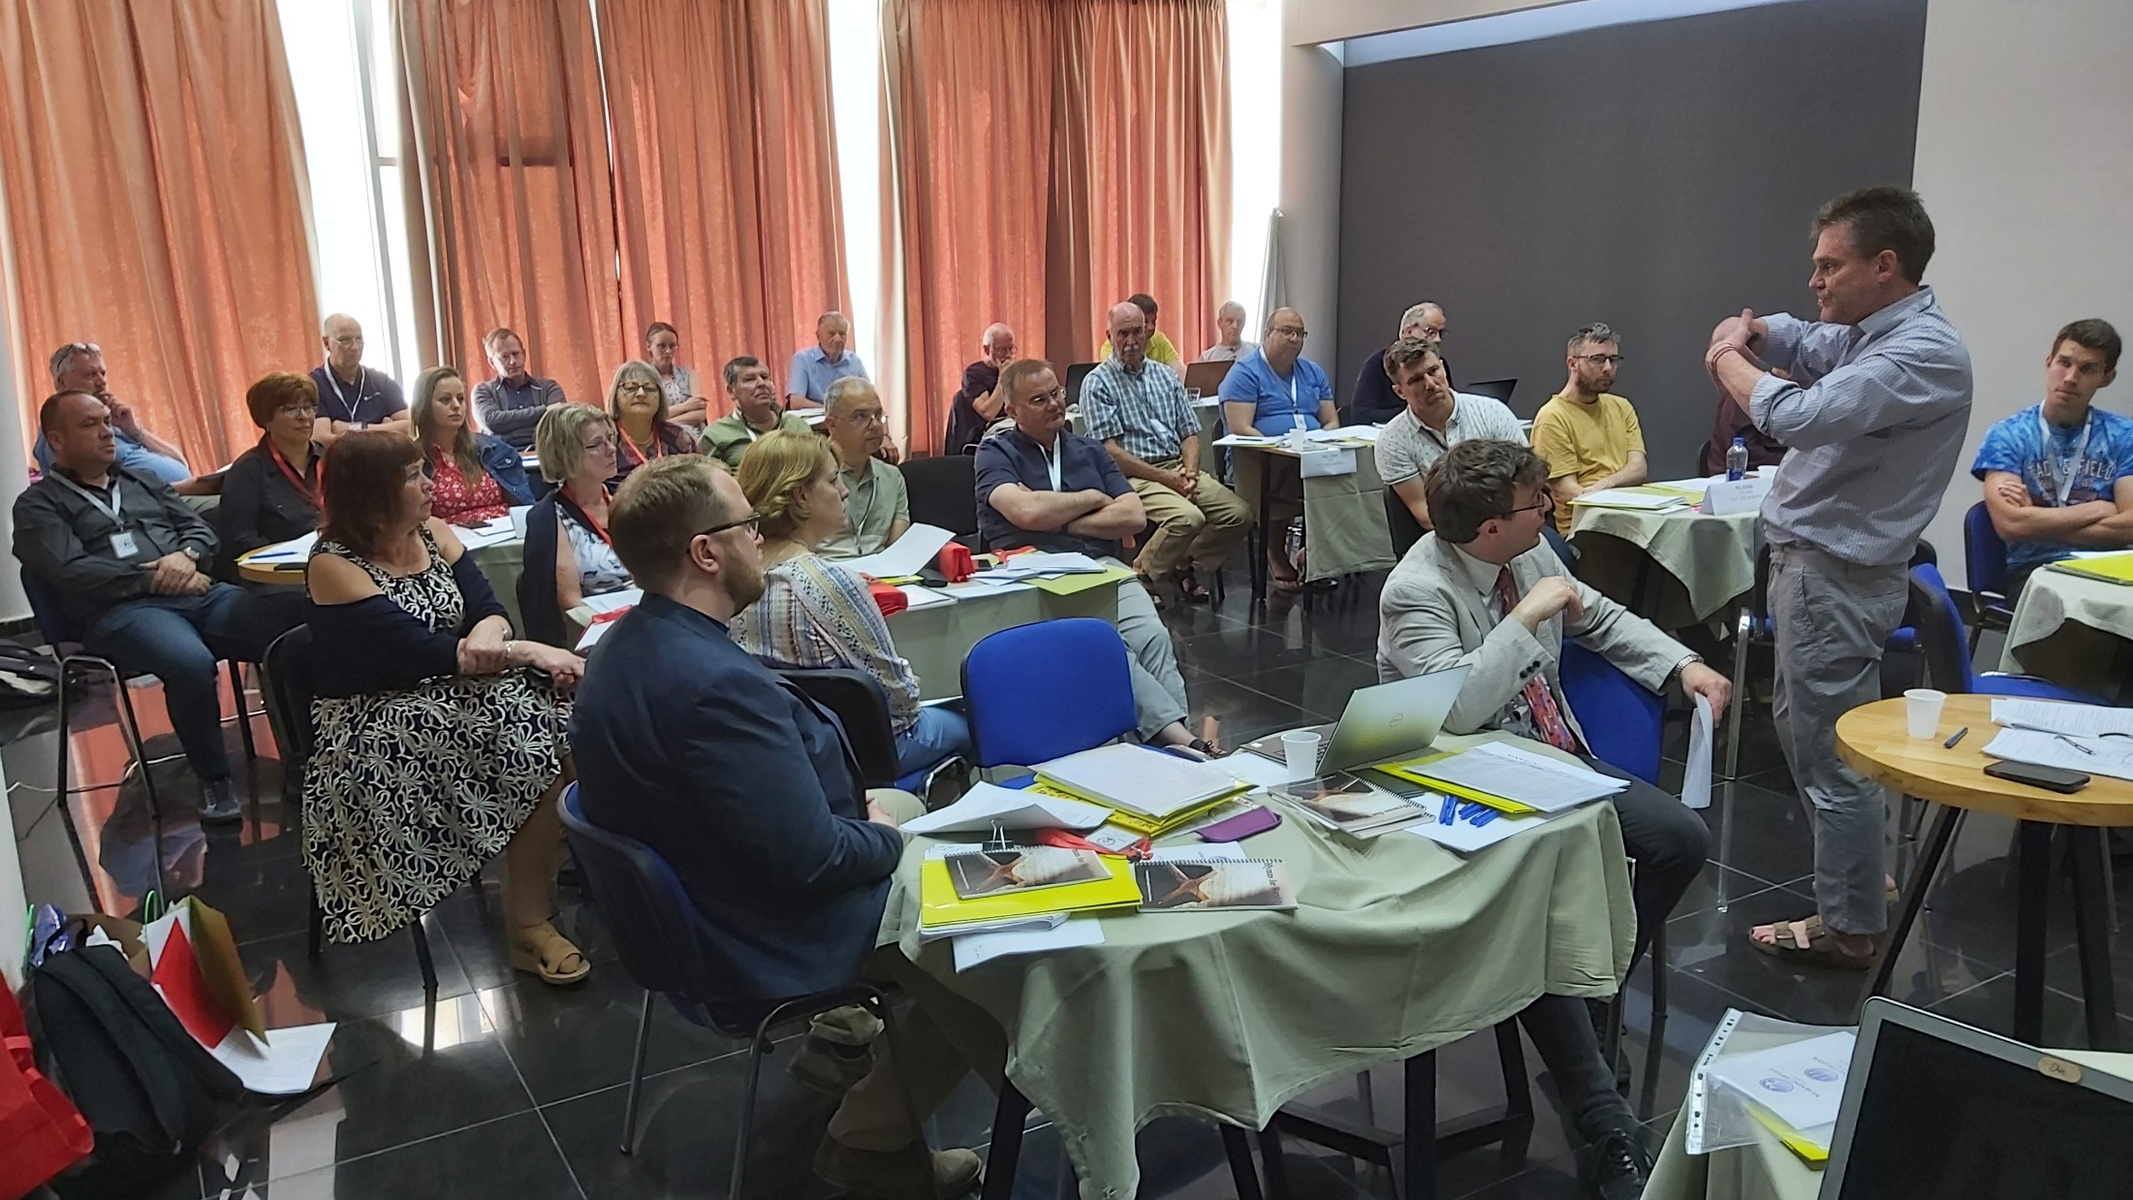
CELC Europe – May 2022
Notes:
Add notes!

Slide 9
Notes:
The Asia One Team comprises 17 missionaries serving 16 different countries throughout Asia. The team, largely based in Thailand and Hong Kong, partner with God’s people in Asia to equip, encourage, and empower others to bring the good news of Jesus Christ to 1.8 billion unreached souls throughout Asia. Asia Lutheran Seminary continues to provide theological education across the continent.

Slide 10
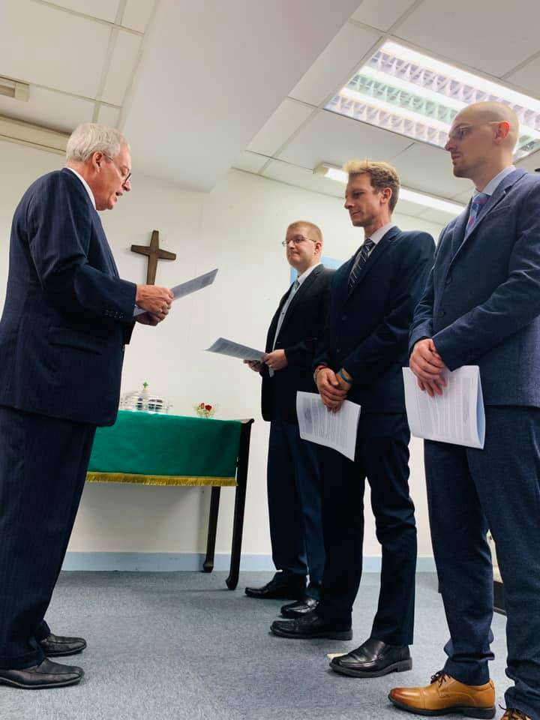
East Asia/Asia Lutheran Seminary
Notes:
Pastors Dan Kingsbury (far right) and Tony Barthels (second from right), graduates of Asia Lutheran Seminary, were given permanent calls to the East Asia team. Security continues to be a serious concern. Asia Lutheran Seminary continues to train leaders for service in East Asia, largely though remote training. Rev. Dr. Jon Bare, Director of the Pastoral Studies Institute (PSI), has accepted a call to take over as Asia Lutheran Seminary as Steve Witte (right photo, far left) will be retiring in July 2023.
Fast Facts:
Asia Lutheran Seminary is teaching 56 online students, 29 more than previous semesters.
There are 31 church leaders or pastors being mentored in East Asia.
53 small groups gather weekly in East Asia.

Slide 11
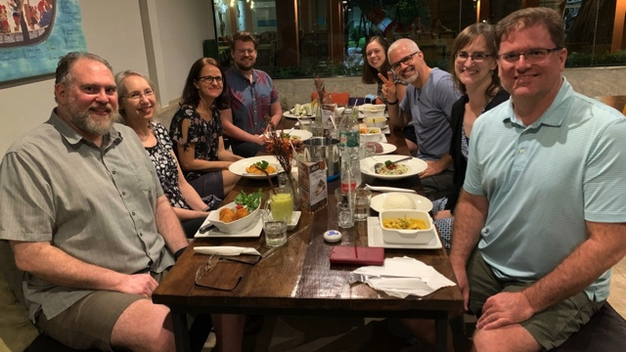
Combined Asia One Team based in
Chiang Mai, Thailand
Notes:
In part, in reaction to security risks, World Missions is looking to combine the Asia One Team and the East Asia One Team. The merge will enable us to combine the strengths of the teams and eventually use Asia Lutheran Seminary to lend aid to other Asia teams.

Slide 12
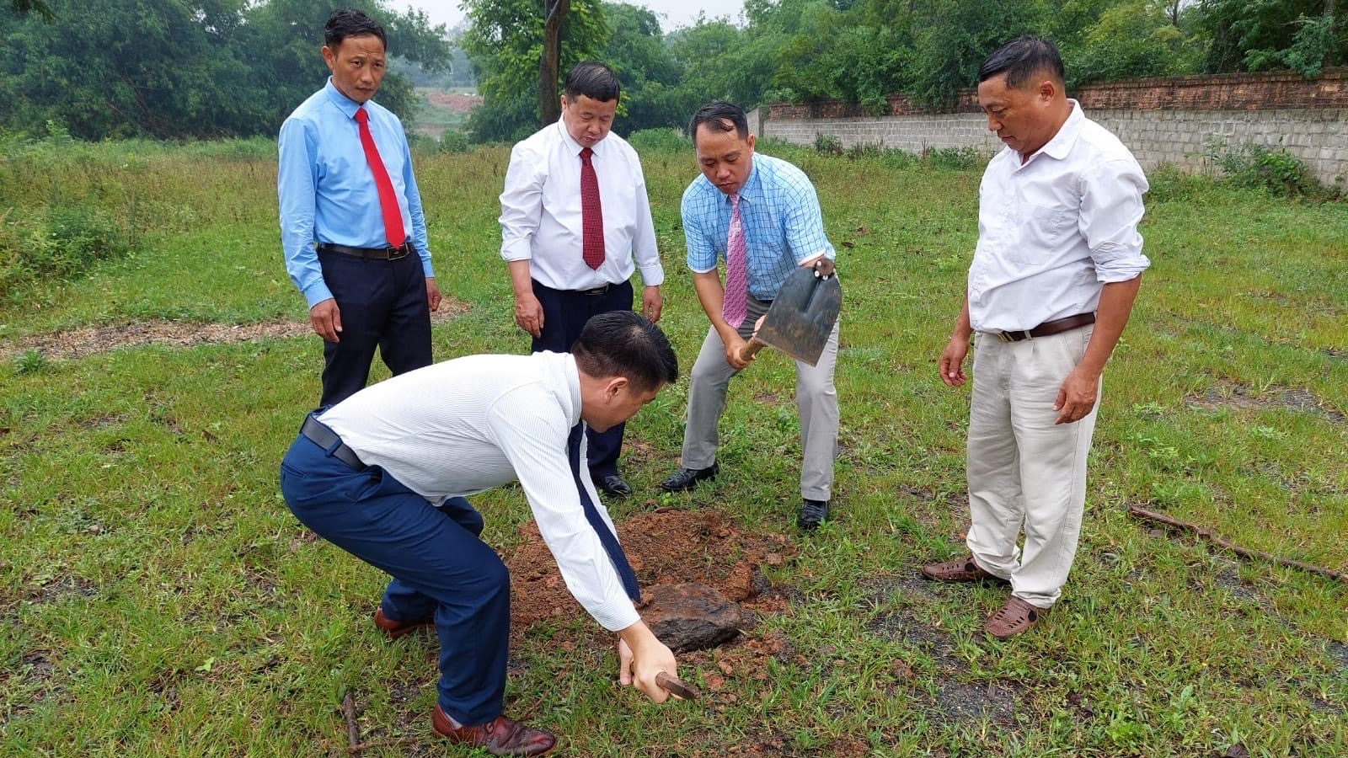
Groundbreaking
in Vietnam
Notes:
God continues to bless WELS’ outreach efforts in Vietnam, despite challenges and unexpected setbacks.
In October 2021, WELS leaders were able to travel to Vietnam for the first time since COVID-19 restrictions halted international travel in March 2020. This trip allowed them to conduct needed in-person discussions about the theological education center being built in Hanoi for the training of leaders in the Hmong Fellowship Church (HFC). Also in October, Joel Nitz traveled to Vietnam for the first time since he was called to serve the Hmong in Vietnam in February 2020. During the 18 months when he could not travel to Vietnam, Nitz took classes to learn the Hmong language, wrote courses for use in rural congregations, and taught several classes online to Hmong church leaders.
Building plans are still being finalized, but an official groundbreaking took place on May 15, 2022, in preparation for the land to be cleared and graded. Missionary Bounkeo Lor spoke the words of dedication over Zoom with many WELS representatives online, while the HFC leaders put the shovel in the ground and placed the first stone.
Stay up to date on progress at wels.net/vietnamhmongoutreach.

Slide 13
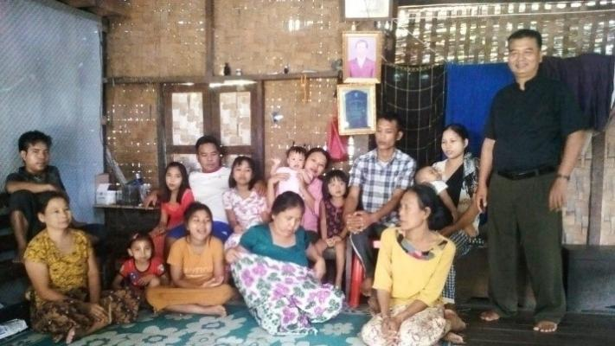
Myanmar
Notes:
Contact with a Lutheran church body in Myanmar was established late 2020 when a pastor there reached out to Rev. Benjamin Steenbock of Zion Lutheran Church in Hartland, WI, after seeing online Bible studies and sermons. This pastor along with four congregations in western Myanmar had recently broken away from the Lutheran Church of Myanmar because of its alignment with the Lutheran World Federation and the doctrinal corruption that was taking place. Their initial conversations led to Pastor Steenbock teaching Bible and doctrine to a group of leaders from the newly formed Myanmar Lutheran Evangelical Church (MLEC). After several months of teaching and building relationships, Rev. Steenbock reached out to the Asia One Team and they contacted the pastor and other church leaders.
Plans were being made to take teaching to the next level and begin conversations about fellowship, but in January 2021 the Myanmar military staged a coup, jailed and killed elected leaders, and began attacking various ethnic populations throughout the country. Over the past year, fighting intensified and spread across the country. The Chin/Sagaing region of the country where the MLEC is located started to see intense fighting on Christmas Eve 2021. The area continues to have the most intense fighting in the country. Some MLEC members have died, many have fled to neighboring India, others have fled to mountain encampments, and many have lost homes and all but the clothes on their backs.
Relief Activity: The Asia One Team with the support of a Christian Aid & Relief grant provided funds to purchase badly needed relief supplies to help meet the immediate needs of members and others in the community. Relief teams provided relief to 45 families (about 300 people). 20 of those families were not affiliated with the church. God opened many doors to meet physical and spiritual needs of people both within and outside the church.
Spiritual Support: On many occasions, the pastor from Myanmar and other church leaders were able to gather in people’s homes or in camps to lead devotions, worship, pray, and even baptize a few people in the homes and camps where they gathered. A WELS affiliated church in Thailand contributed a supply of Luther’s Small Catechisms and adult and children’s devotional material in Burmese.
The Asia One Team is hopeful that conditions may improve in Myanmar enough for regular instruction to continue. God willing, the country will settle down enough for a visit some time in the future.

Slide 14
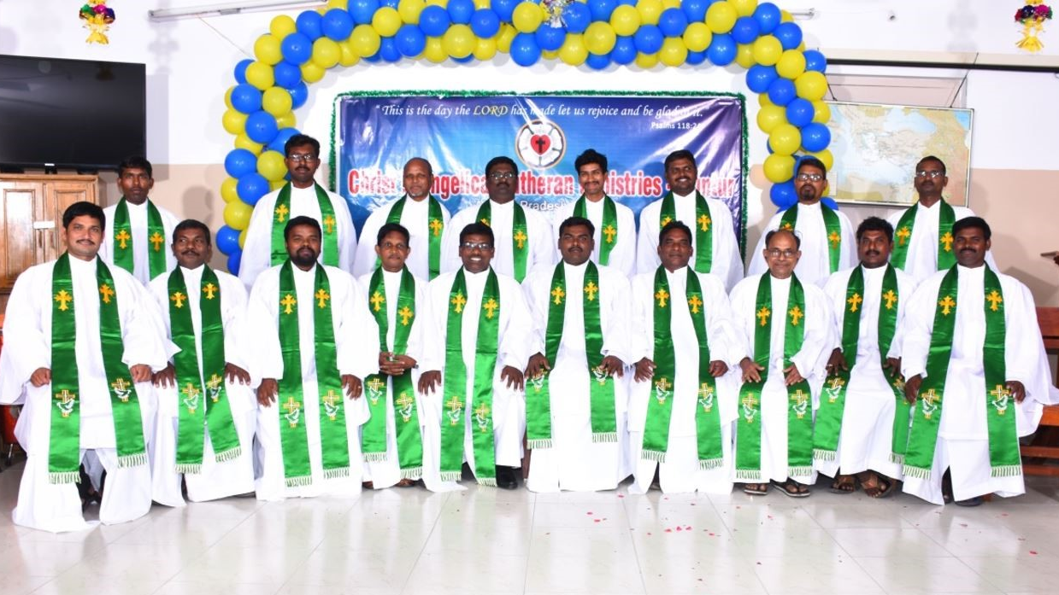
Seminary graduation in India
Notes:
WELS supports a Lutheran seminary in Guntur, Andhra Pradesh, India to teach God’s Word and to train workers in the Christ Evangelical Lutheran Ministries (CELM) of India. On Friday, March 25, 2022, 18 students graduated after seven years of study. Out of the 18 students, 14 of them belong to Telugu states (Andhra Pradesh and Telangana) and 4 of them belong to North India (Madhya Pradesh, Chattishgarh, and Uttar Pradesh). All of them have gone back to their congregations for full-time gospel work. WELS provided laptops to all graduates for their continuing education.
Over 130 more men have requested to join the next pre-seminary class. Learn more at wels.net/india.

Slide 15
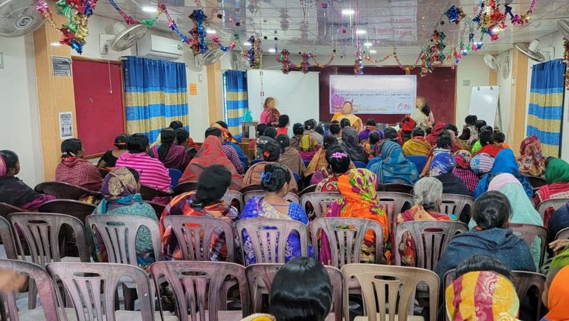
Mission growth in Bangladesh
Notes:
Haris*, a Christian young man from Bangladesh, became a WELS member in a large Midwest city. He expressed the desire to share the gospel with more Muslims, both in his new city in America and in his homeland. He is now enrolled in our synod’s Pastoral Studies Institute. When his father, a strong Christian, passed away, he inherited two Bible schools for the training of evangelists in Bangladesh. WELS is working with Haris to provide solid scriptural training for the teachers and the students.
Pictured: 109 women and 107 children from six different churches all gathered in December 2021 for a Women and Children’s Day Camp. All these women and children are Muslim and Hindu background believers and were baptized in the last 1-2 years. The wife of our U.S.-based Bangladeshi contact coordinated both camps.
*Name changed due to the sensitive nature of his work.

Slide 16
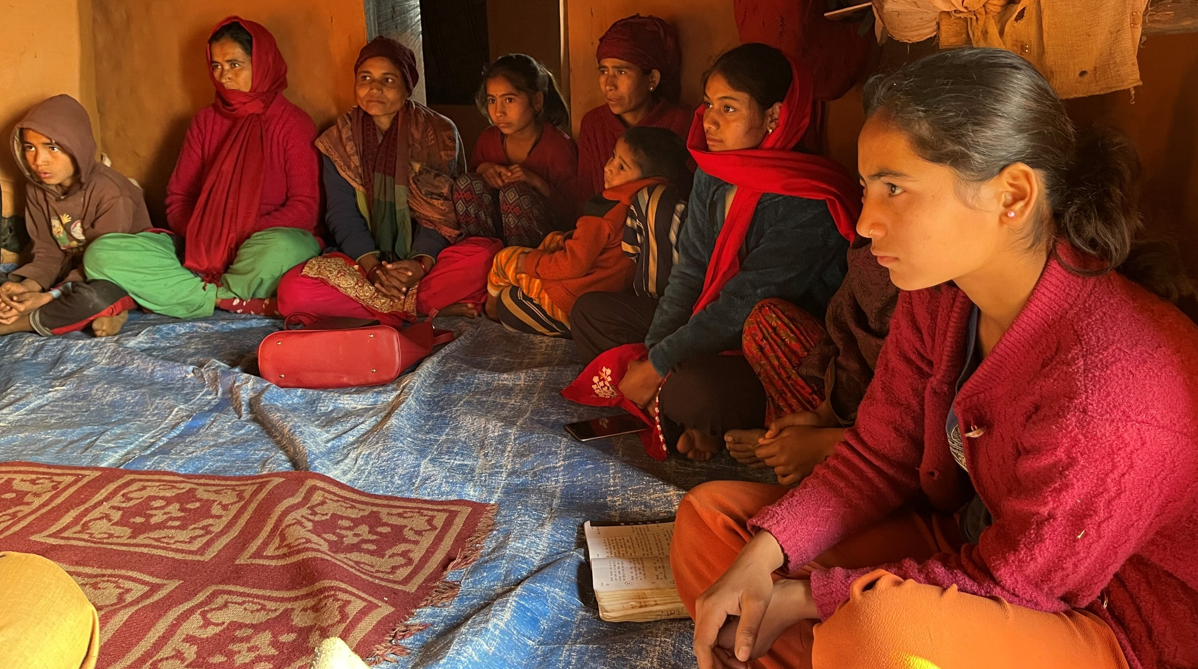
South Asia
Notes:
Pictured: January visit to churches a Hindu nation in South Asia
In spite of persecution, WELS’ mission to this Hindu nation is experiencing more growth than at any time in its history. Only 1% of the population is Christian.
The mission to this Hindu nation in South Asia began with two people and today serves more than 5,000.
A Bible Institute provides instructions to 125 church leaders.
A seminary current trains two groups of students: Group 1 includes 11 circuit leaders and Group 2 includes 14 pastors and evangelists.
National leaders provide discipleship training in each of the congregations on maturity (being in the word of God), ministry (serving others with our talent and treasure), and mission (sharing the gospel with others).

Slide 17
Notes:
The Latin America mission team uses Academia Cristo, an online outreach and training tool, to share God’s grace with as many people as possible as well as identify and train potential leaders who can plant churches.

Slide 18
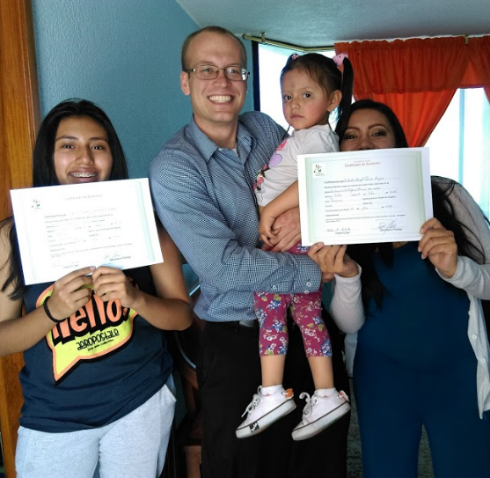
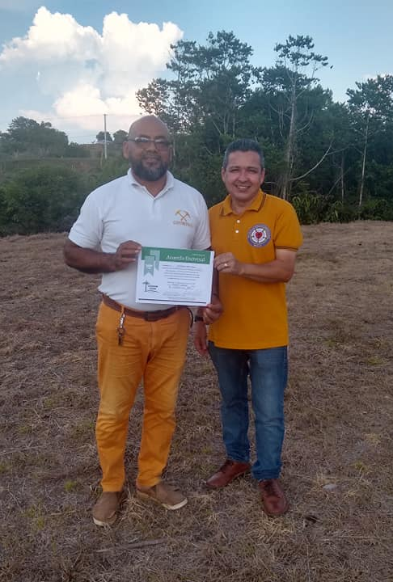
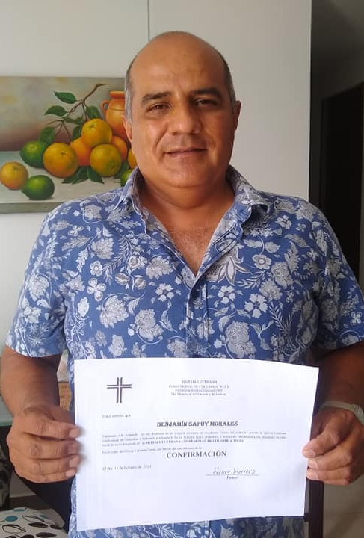
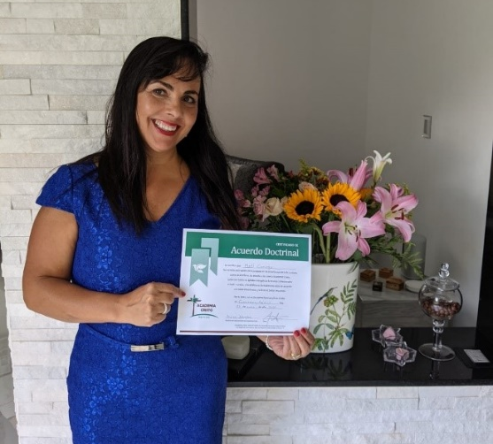
Notes:
Pictured: Confirmands of Academia Cristo outreach efforts from Ecuador, Mexico, and Colombia
Amazing blessings through Academia Cristo:
1.3 million followers on Facebook
565,000+ people have downloaded the Academia Cristo mobile app that launched in February 2020
1,300+ people have completed the self-led courses on the mobile app since March 2020 and are signed up for live courses
410+ people have completed one live course since March 2020 with a WELS missionary or national partner
58 people have been confirmed as Lutherans through Academia Cristo
There are 73 Academia Cristo students who have said they are currently sharing Bible materials with a group

Slide 19
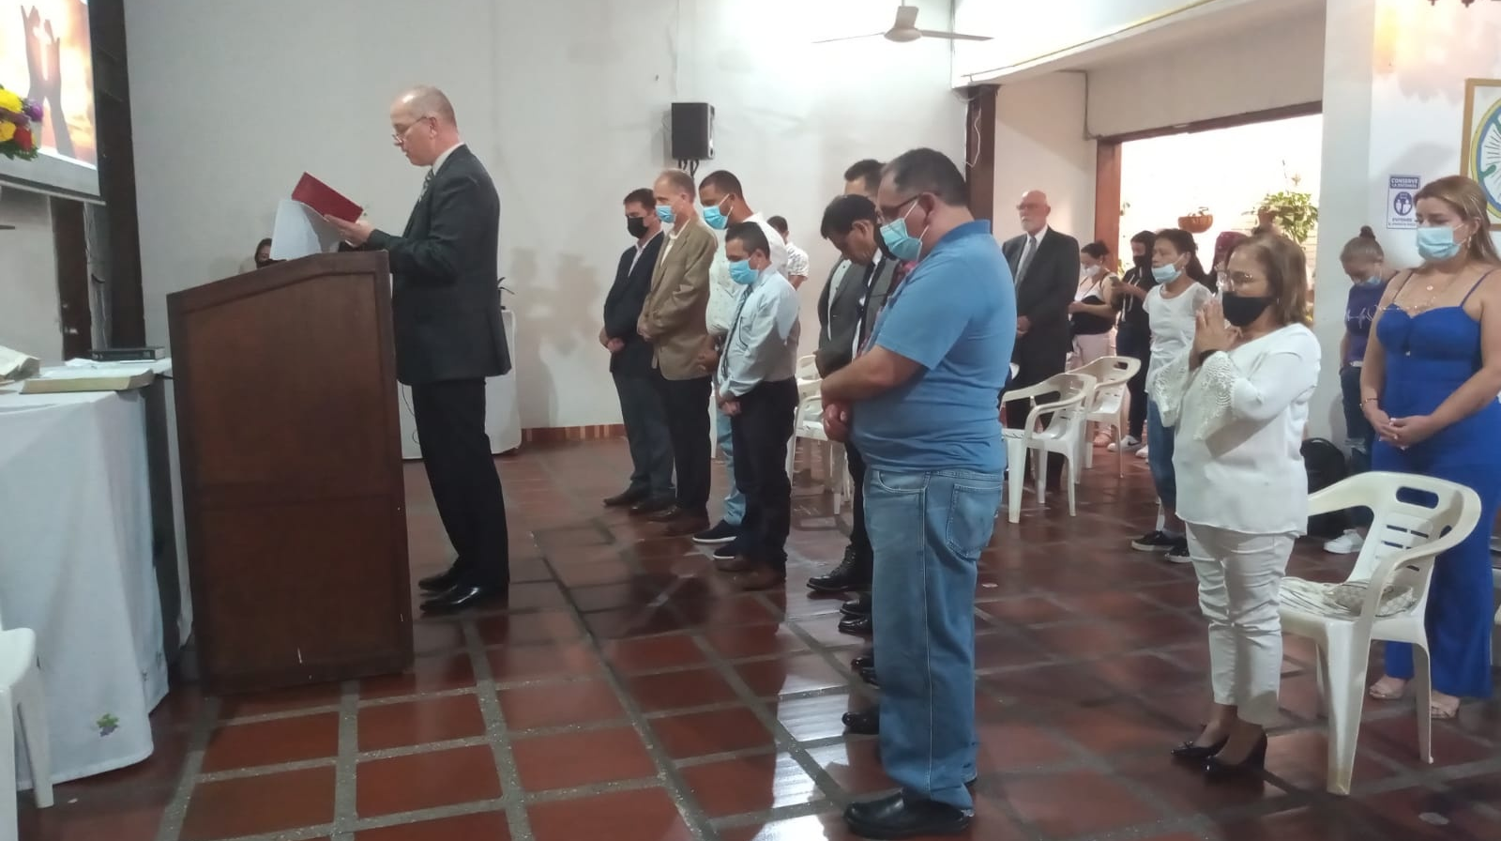
New synod in Latin America
Notes:
In October 2021, representatives from WELS and WELS’ sister churches throughout Latin America met in Medellín, Colombia, to form a new synod: Iglesia Cristo WELS Internacional. Founding members come from churches in Bolivia, Colombia, Dominican Republic, Haiti, and Venezuela. As part of a synod, these churches will be able to do mission work together, train pastors together, and support each other with prayers and fellowship. Rev. Henry Herrera, a pastor in Colombia, serves as president of Iglesia Cristo WELS Internacional.
Synod membership is expected to swell in the future as new groups gathered during the Academia Cristo training efforts complete a two-year confessional process called Ruta Cristo (Christ path). Currently 12 groups are on that two-year path, with dozens more possible in the upcoming year. Leaders who complete the highest level of Academia Cristo classes also will be considered candidates for a new seminary program led by Iglesia Cristo WELS Internacional and supported by WELS missionaries.
Read more:
https://wels.net/new-synod-in-latin-america-forms/
https://forwardinchrist.net/path-of-academia-cristo/

Slide 20
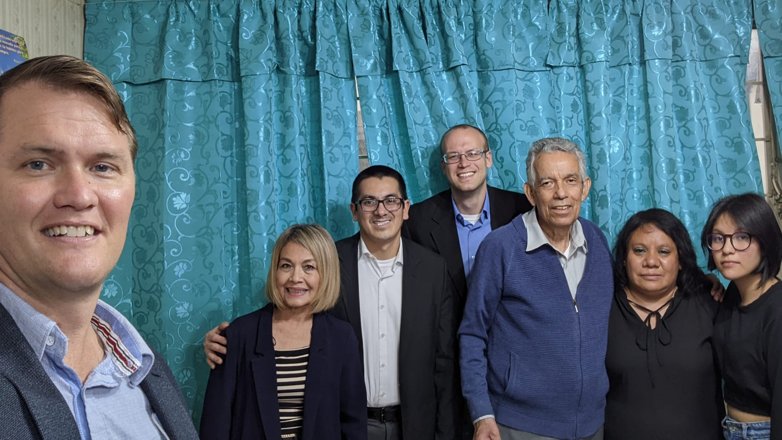
New missionaries to Latin America
Notes:
Five new missionaries accepted calls to serve on the Latin America mission team in the past year. Pictured is Nixon Vivar (third from left) on a recent trip to Mexico to visit Academia Cristo students with Team Leader Andrew Johnston (far left) and Missionary Nathan Schulte (fourth from left). Nixon Vivar accepted a one-year call to the Latin America team to assist with the teaching workload that was left when Michael Hartman, previous Latin America team leader, accepted the call to serve as a missionary in London.
Other missionaries include:
Teacher Elise Gross - Dean of Women
Missionary Gross is responsible for welcoming women into the Academia Cristo program, teaching courses, and mentoring women who have started groups where they’re sharing the gospel. Read more: https://wels.net/opportunities-for-womens-ministry-in-latin-america/
Carl Leyrer – Pilot Program Director: Diaspora Ministry
Pastor Leyrer has served in Latin America for much of his ministry. In this retirement call, he will be responsible for determining how Academia Cristo online training efforts could be utilized in the United States/Canada. He will be figuring out how to connect those students with existing WELS churches, and/or encouraging them to start their own Christian group using Academia Cristo resources.
Luis Acosta – Multiplication Missionary
Luis Acosta will be serving as a Multiplication Missionary on the Latin America team, focusing on Academia Cristo students in the northern third of Latin America. He previously served at Risen Savior in Milwaukee, WI. He will teach classes online, mentor students who are leading Bible study groups, be the main point of contact for sister churches in Peru and Chile and will work with the team to determine how Academia Cristo might be used in low literacy groups in Latin America.
Luke Beilke – Dean of Students
Teacher Luke Beilke who is currently serving at Ascension in Sarasota, FL, accepted the call to serve as Dean of Students on the Latin America team right before Easter. He will be the main point of contact for Academia Cristo students from when they finish courses on the app through to when they receive a mentor from the Latin America mission team. He’ll also be teaching some classes, mentoring leaders who are starting Bible study groups, and serving on the instruction team, where he will use his experience and training as a teacher to encourage best practices in adult education.

Slide 21
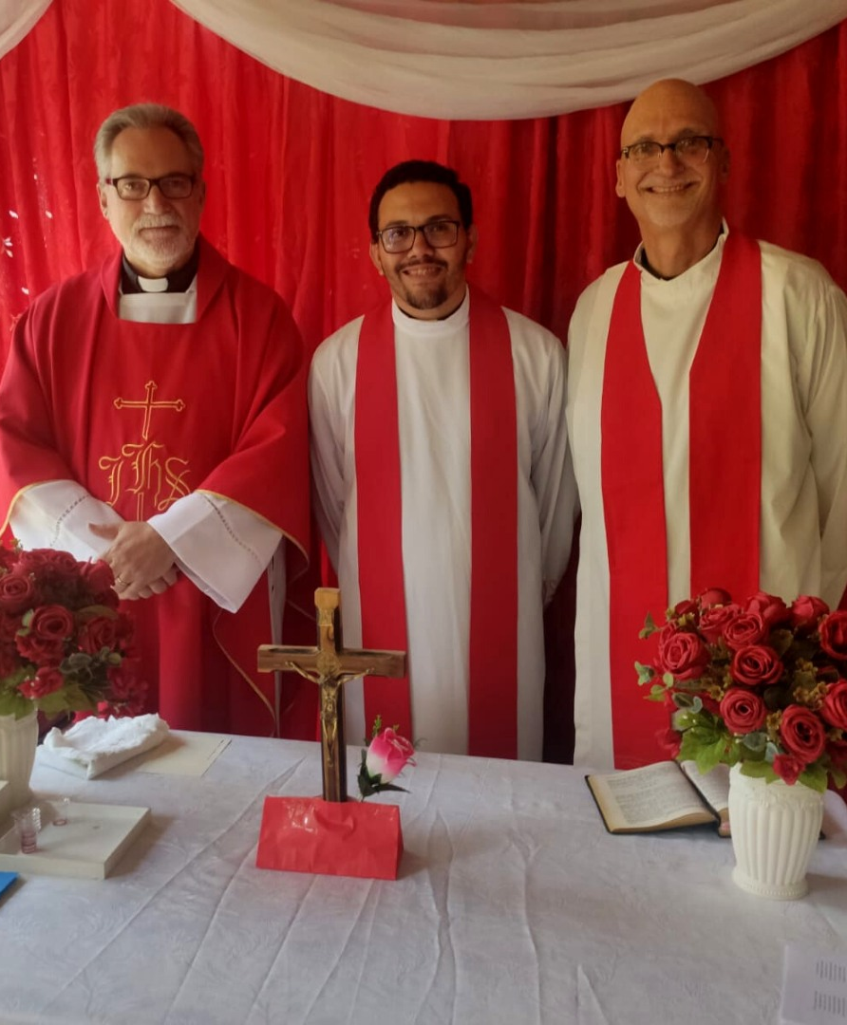
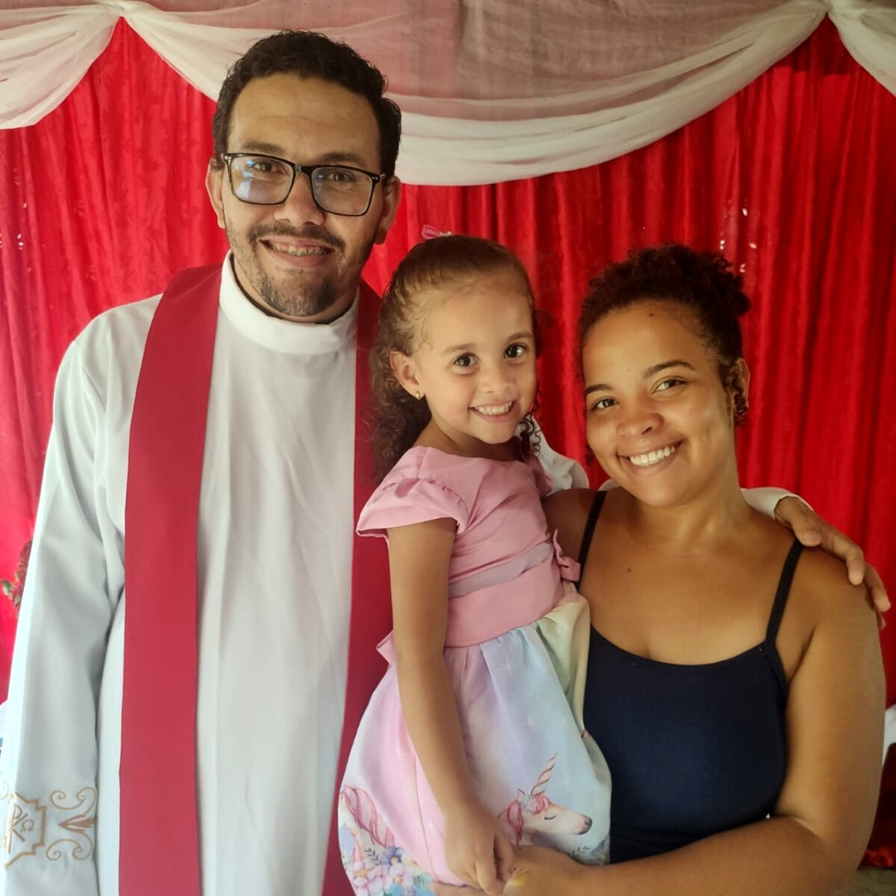
Brazil
Notes:
Rev. Denício Godoy was ordained and commissioned by the Lutheran Church of Portugal as a missionary in Brazil on April 3, 2022! The celebration took place in Dom Cavati and was officiated by Rev. Artur Villares, president of the Lutheran Church of Portugal, and Rev. Kenneth Cherney, Old Testament professor at Wisconsin Lutheran Seminary.
Rev. Godoy connected online with Rev. Villares from the Lutheran Church of Portugal, WELS' sister church, and took classes with him to be colloquized as a Confessional Lutheran pastor. Rev. Godoy will begin outreach in Brazil as a mission arm of the Lutheran Church of Portugal, with support from the WELS Europe team and continued encouragement from Rev. Cherney. We praise God for this new outpost for the gospel in Brazil!
Learn more about the Lutheran Church of Portugal and how they came to connect with Pastor Godoy at wels.net/portugal.

Slide 22
Notes:
The WELS One Africa Team currently works with established church bodies in Cameroon, Ethiopia, Kenya, Malawi, Nigeria, and Zambia, partnering in outreach and assisting with theological education programs. The team is also working with groups or exploring outreach in seven additional African countries and following up on contacts identified through Multi-Language Production’s TELL program. Currently, nine missionaries serve on the One Africa Team.

Slide 23
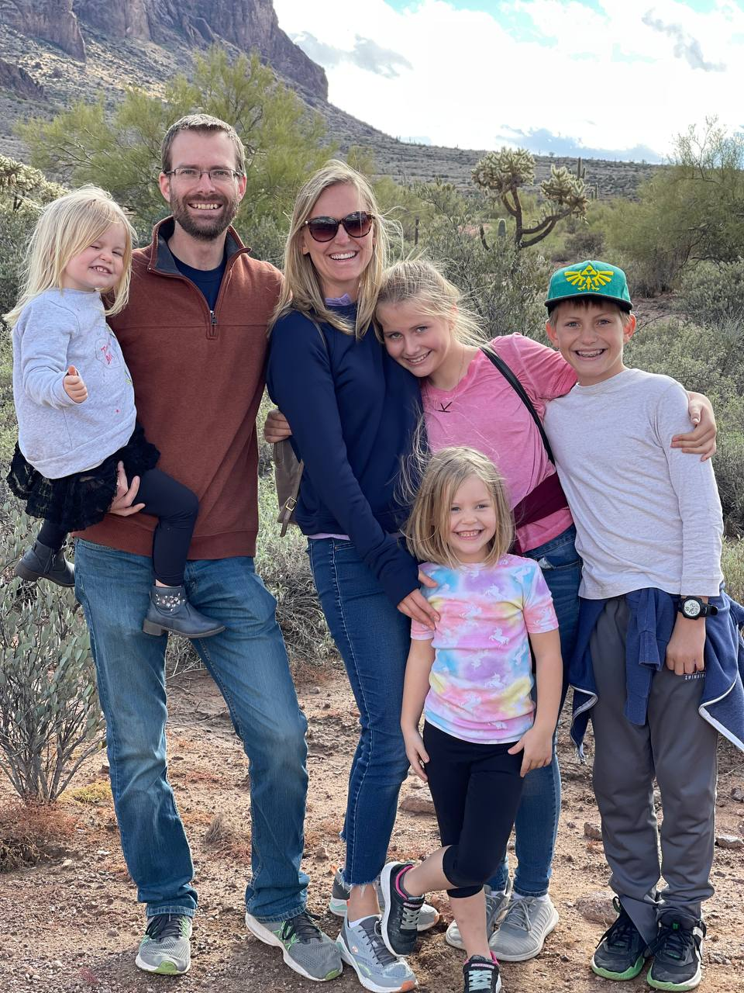
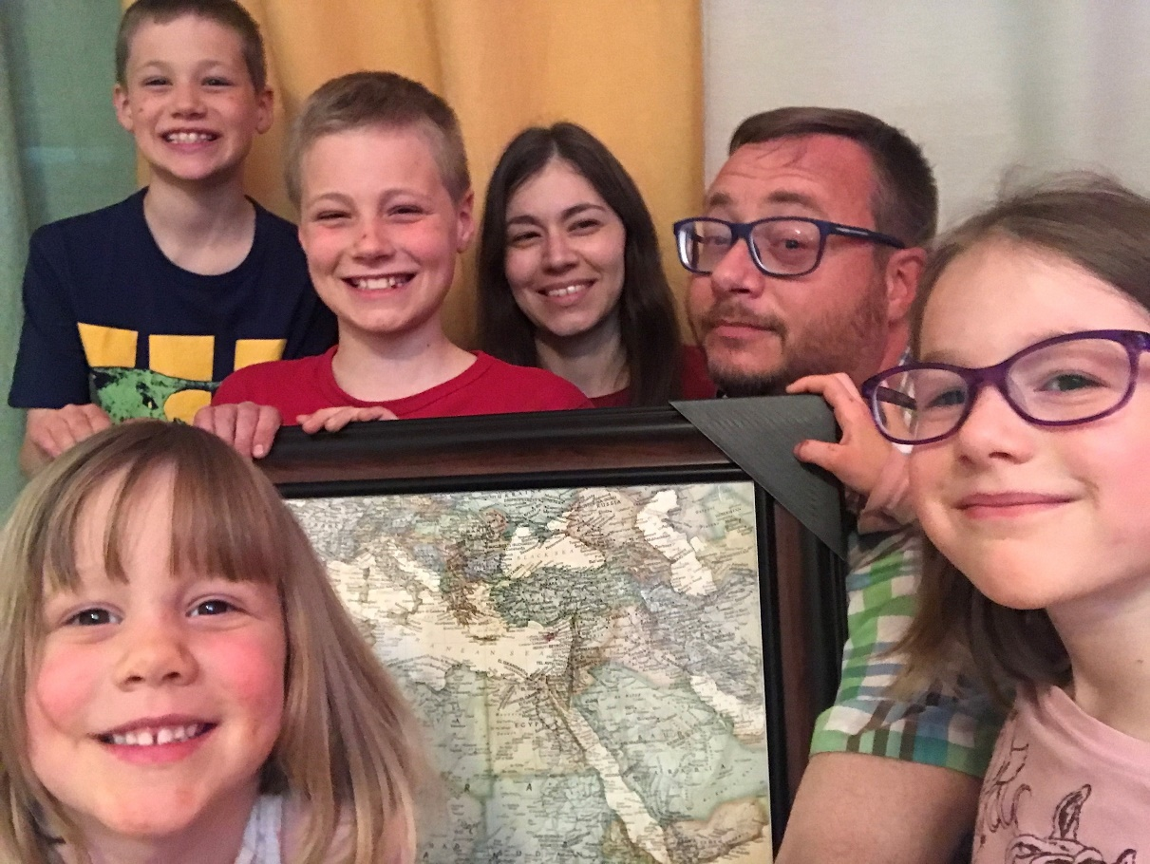
New missionaries to Africa
Notes:
Rev. Benjamin Foxen (Pictured Left: Cross of Glory - Peoria, AZ) and Rev. Keegan Dowling (Pictured right: Abiding Word – Orleans, ON, Canada) recently accepted calls to serve as missionaries on the One Africa Team. They will be commissioned at the Taste of Missions worship service on June 11, 2022. Both will be moving to Lusaka, Zambia, in the upcoming months.
Read more these men and their families at tasteofmissions.com/new-missionaries-2022.

Slide 24
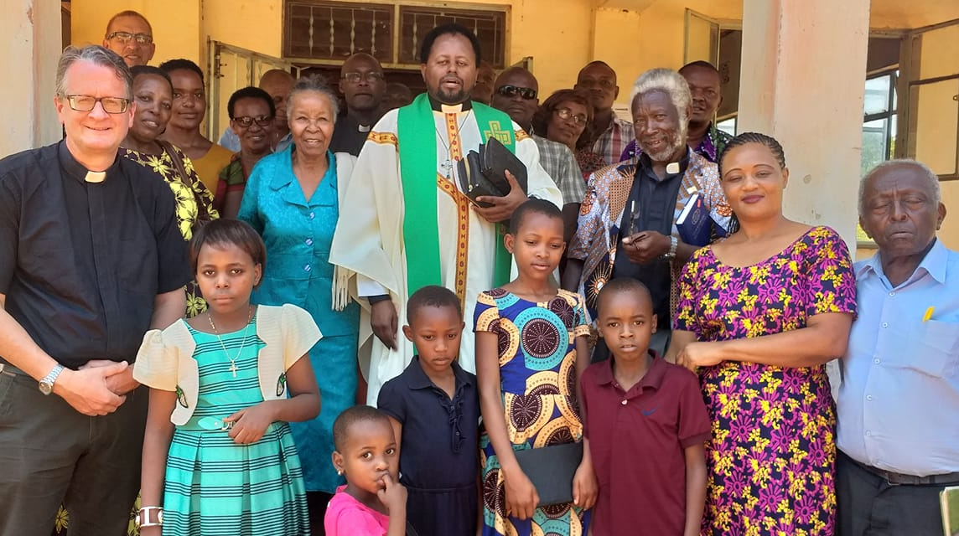
Outreach trips resume
Tanzania
Notes:
In 2021/2022, missionaries from the One Africa Team were able to make several trips to visit various church groups throughout Africa. Many of these trips were originally delayed due to COVID travel restrictions. Missionaries and other national church partners traveled to Tanzania, Kenya, Uganda, Cameroon, and Ethiopia.
Tanzania (pictured above)
In April 2021, Missionary John Hartmann made a preliminary visit to Tanzania to meet with a dozen African Mission Evangelical Church (AMEC) pastors to learn more about their history and introduce them to WELS doctrine and beliefs. In November 2021, Missionary John Roebke and Missionary Hartmann returned with Kenyan national pastor Mark Anariko Onunda to continue potential fellowship discussion. It is the prayer of AMEC to partner with WELS to provide solid confessional Lutheran training for their pastors. The One Africa Team will return in 2022 to continue their discussions.
Kenya
In 2019, the Lutheran Congregations in Mission for Christ (LCMC) – Kenya joined in fellowship with WELS. Because of the pandemic, no One Africa Team members were able to visit. Missionaries Howard Mohlke and John Roebke were able to travel to Kenya in August 2021. They held leaders’ workshops, saw some of the buildings WELS helped build, and shared messages and encouragement from the Bible. Then, in October 2021, One Africa Team Missionary Dan Witte traveled to Kenya to teach a course on African Church History to three pastors of the LCMC – Kenya. He was also able to participate in the dedication of St. Peter’s Kindu Church in Eastern Kenya.
Cameroon
One Africa Team missionaries traveled to Cameroon in October to meet with a group of pastors and laymen of the Lutheran Church of Cameroon (LCC). After not meeting in-person for two years, this gathering was appreciated. The group discussed the partnership in the ministry that these groups share, the future of the Lutheran Church of Cameroon seminary, ministry training opportunities, and other ministry topics.
Ethiopia
In October 2021, One Africa Team missionaries traveled to Ethiopia to visit WELS’ sister church, the Lutheran Church of Ethiopia (LCE). God greatly blessed mission work in Ethiopia through a Lutheran elementary school in Dukem with two separate campuses. Current enrollment is 759, 10x more than the LCE had originally planned.
Read more: wels.net/african-outreach-trips-fall-2021/

Slide 25
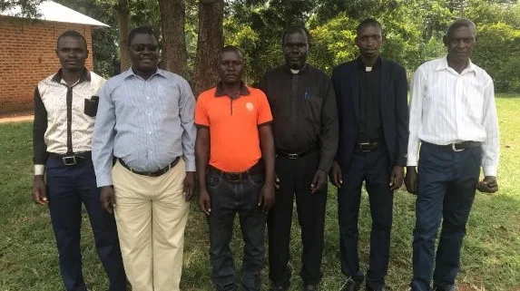
Obadiah Lutheran Synod - Uganda
Notes:
Uganda
Missionaries John Holtz and Dan Kroll visited Obadiah Lutheran Synod in Uganda in early October 2021 . They were evaluating and preparing the last steps needed before recommending that Obadiah Lutheran Synod be brought into fellowship
with WELS and visited some of their churches. Missionary Holtz was also able to meet with seven students who gathered online to study Luther’s Small Catechism during the pandemic. Read more about their trip from Missionary John Holtz.
Obadiah Lutheran Church in Uganda (leadership is pictured above) recently drafted a request for doctrinal unity/fellowship with WELS, which includes a summary of doctrine and practice and a report describing the relationship between their synod and WELS/One Africa Team. The prayer is that they will be brought into fellowship at the 2023 Synod Convention.

Slide 26
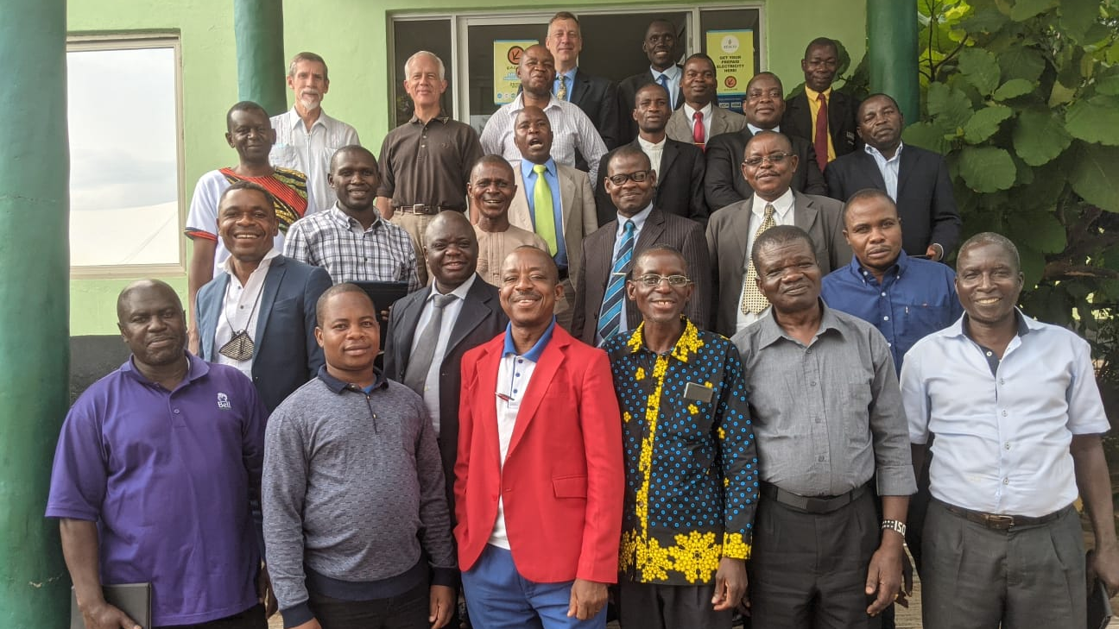
Theological education in Africa through the Confessional Lutheran Institute
Notes:
The Confessional Lutheran Institute (CLI), the educational arm of the One Africa Team, exists to equip, enhance, and enable African pastors within Confessional Evangelical Lutheran Conference (CELC)-member churches throughout Africa. The CLI seeks to engage the active pastors of these churches through formal continuing education and informal professional development opportunities. The CLI also provides seminary consultation to equip the worker training systems within these church bodies for the training of their own future pastors. Learn more at https://cliafrica.net/.
Pictured: In June 2020, the Confessional Lutheran Institute (CLI) formed a cohort of 19 ordained African Lutheran pastors for continuing education. They met March 31-April 7, 2022, for a seven-day Psalms study in Lusaka, Zambia. This Psalms course was the third in a series of nine courses and a final thesis, all of which will lead, God willing, to a Bachelor of Divinity degree from Wisconsin Lutheran Seminary (WLS).

Slide 27
Notes:
The Central Africa Medical Mission (CAMM) oversees the Lutheran Mission Rural Health Centre, a permanent clinic in Zambia, and the Lutheran Mobile Clinic in Malawi, where staff travel to five designated villages for a day of clinical work and care. Both clinics focus on providing Christian counseling and education, HIV testing and treatment, malaria treatment, wellness checks and immunizations for children, and treatment of other minor injuries or illnesses. CAMM partners with the Lutheran Church of Central Africa and WELS missionaries to help the spiritual and physical needs of people in Zambia and Malawi.
The WELS Central Africa Medical Mission celebrated their 60th anniversary on Saturday, October 9, 2021, with worship and fellowship in Milwaukee. Wis. More than 30 alumni were present for the activities. You can view photos in our Flickr album (https://www.flickr.com/photos/welsmissionsphotos/albums/72157720049328815) and watch the archived worship service on YouTube (https://www.youtube.com/watch?v=vi87uZiVD8o).
Below is a brief update on how gifts are being used to support gospel ministry through CAMM's Christ-centered healthcare:
CAMM is transitioning the Malawi Mobile Clinic operations over to a fully Malawian staff so they can free up our resources to explore expansion into other African countries and potentially throughout the world.
They have repaired and renovated all of their clinic buildings, including adding private exam and consultation rooms so more patients are comfortable coming to the clinics.
They are supporting disabled children in Malawi by providing transportation to physical therapy services. These children were introduced to CAMM through the local Lutheran Church of Central Africa-Malawi pastor who uses the service the clinic provides to connect with non-members.
CAMM now has the capability to hire more staff as needed. Many of the staff are members of one of our sister churches in Malawi and Zambia, which strengthens CAMM’s relationship with the local churches and the synods overall.

Slide 28
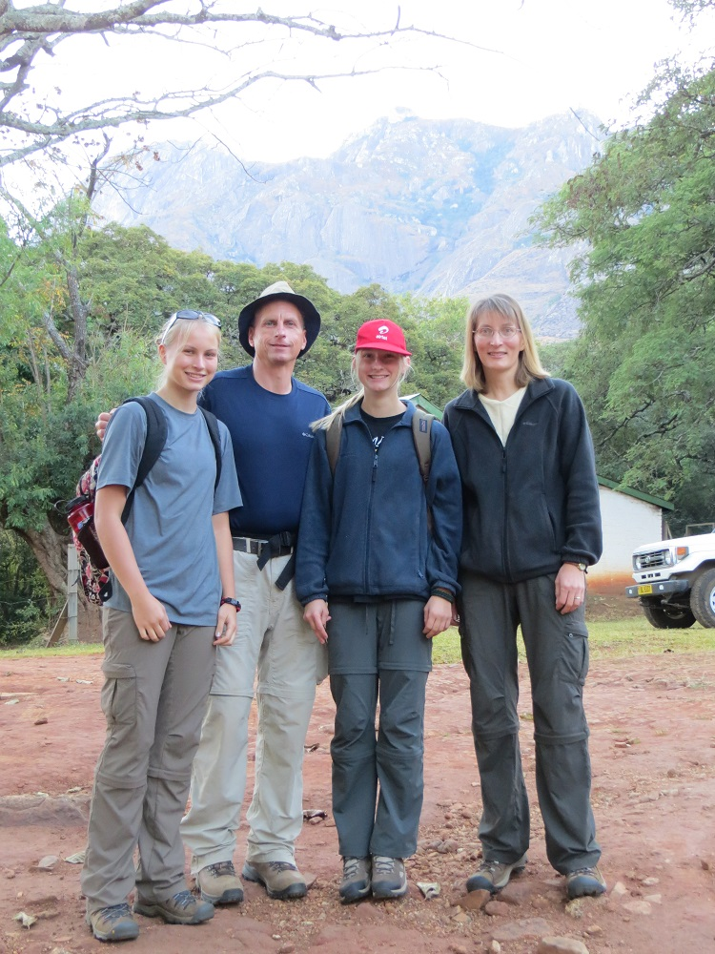
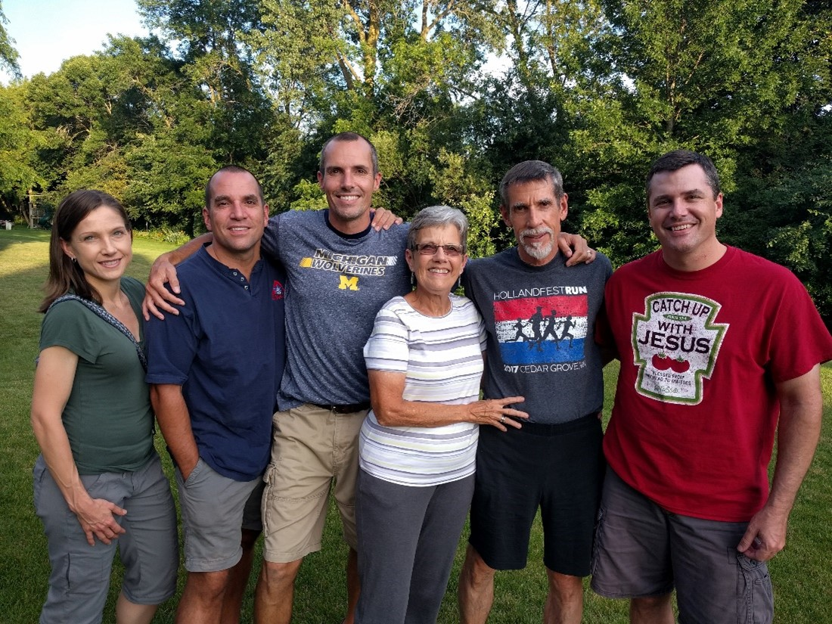
We thank Ernst Wendland and
John Holtz for their service in Africa!
Notes:
Missionary John Holtz, current based in Lilongwe, Malawi, recently accepted a call to serve as Native Christian Counselor on the Native American mission team. We thank him for his service in Africa and pray for him as he begins his new role in a different world mission field.
At the end of the academic school year, long term missionary and seminary teacher, Rev. Dr. Ernst R. Wendland will retire after over 50 years as a missionary in Zambia. His contributions to WELS World Missions and world-wide Biblical translation linguistics are incalculable.

Slide 29
Notes:
The Native American mission serves eight churches, one preaching station, and two Lutheran elementary schools on the Fort Apache Reservation and the San Carlos Apache Reservation in Arizona. The mission is currently served by five missionaries, two national pastors, and one national evangelist.

Slide 30
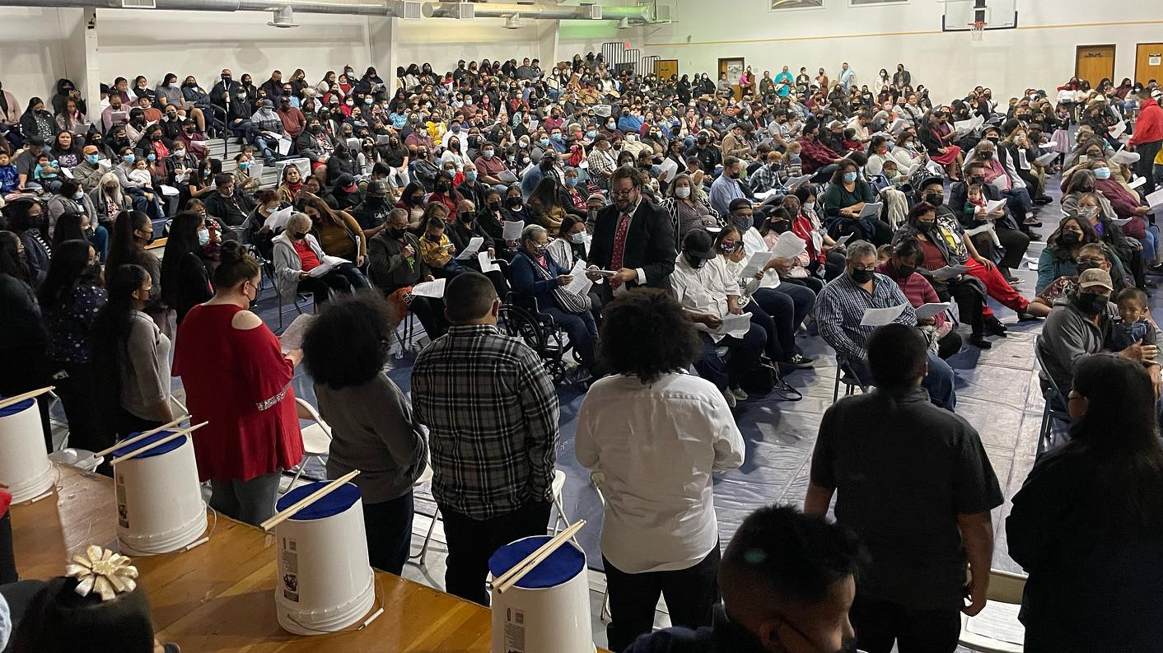
Gatherings and travel resume after COVID restrictions
Notes:
Pictured: More than 740 people, including school kids, gathered at the community hall in Bylas, Ariz., for the Peridot-Our Savior Lutheran School’s Christmas Program in December 2021.
The Native Christians Network has drafted plans to take the gospel to other Native American reservations, and the team looks forward to carrying them out in person as COVID travel restrictions have finally ceased on most reservations. Missionary John Holtz, as the new Native Christian Counselor, will assist in that work.

Slide 31
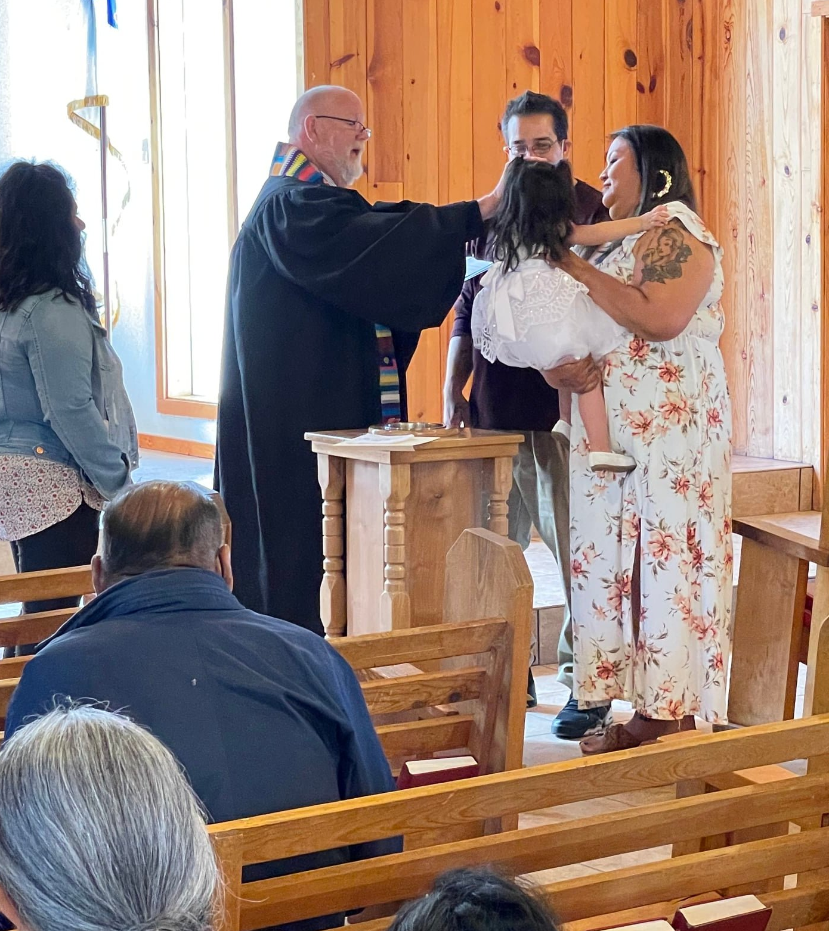
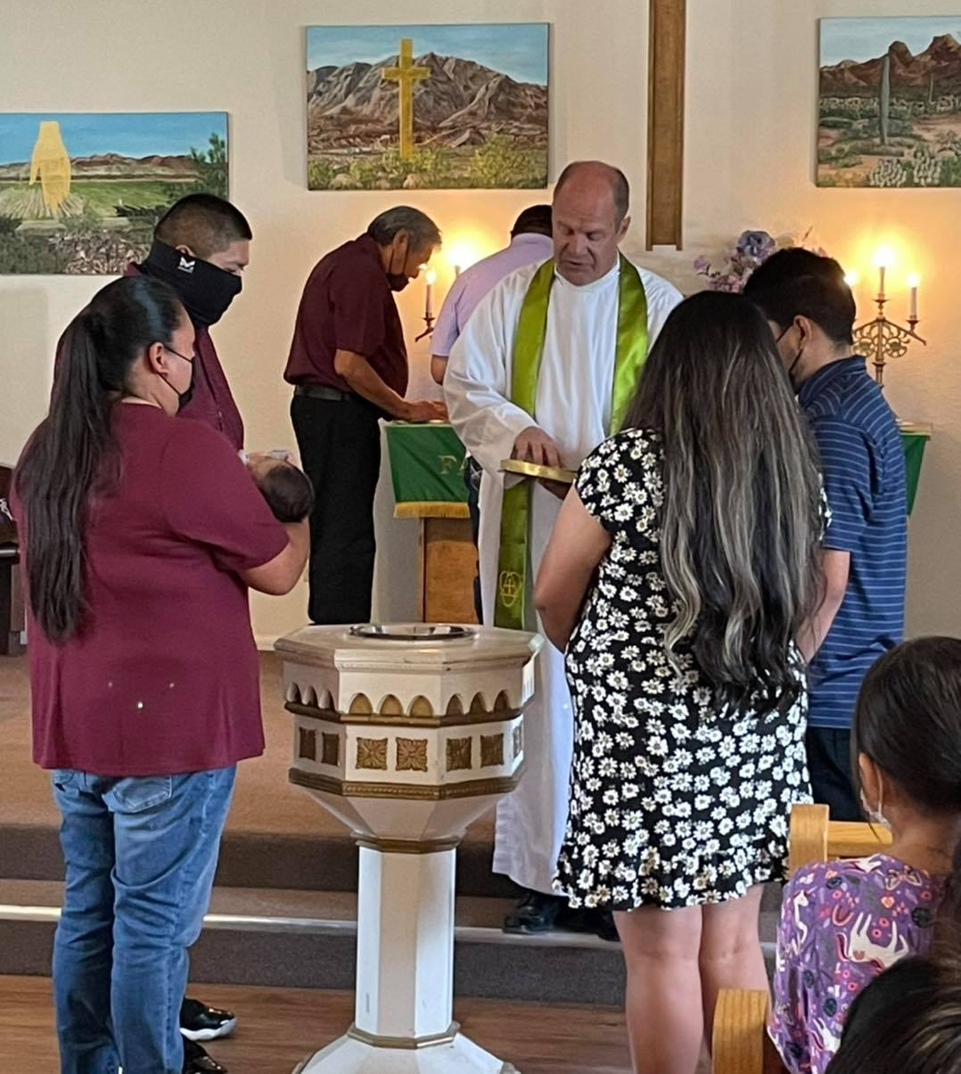
East Fork
Bylas
Notes:
Native American Mission Fast Facts
40% of the baptisms in the Arizona-California district are from Apache congregations.
While attendance was down due to COVID restrictions, two congregations increased giving last year by at least 75%.
Builders for Christ just completed a new teacher housing unit to accommodate more teachers at the growing Peridot-Our Savior’s Lutheran School on the San Carlos Apache Reservation.
2022 marks the 100th anniversary of the Church of the Open Bible in Whiteriver, Ariz.

Slide 32
Notes:
Multi-Language Productions (MLP) has created more than 2.9 million video, audio, print, and online training resources in 56 languages to date. They have also introduced a new online Bible-based training platform called TELL (Think, Evaluate, Learn, and Lead), to bring the gospel to English-speakers around the world. With the Lord’s blessing, the TELL Network will allow for the creation of new TELL platforms in additional languages in the future.
Fast Facts:
The TELL app has been downloaded over 125,000 times.
There are 32,000 active users on the TELL appl.
250+ students have enrolled in live TELL group classes
There are 30+ countries represented in the TELL student body.

Slide 33
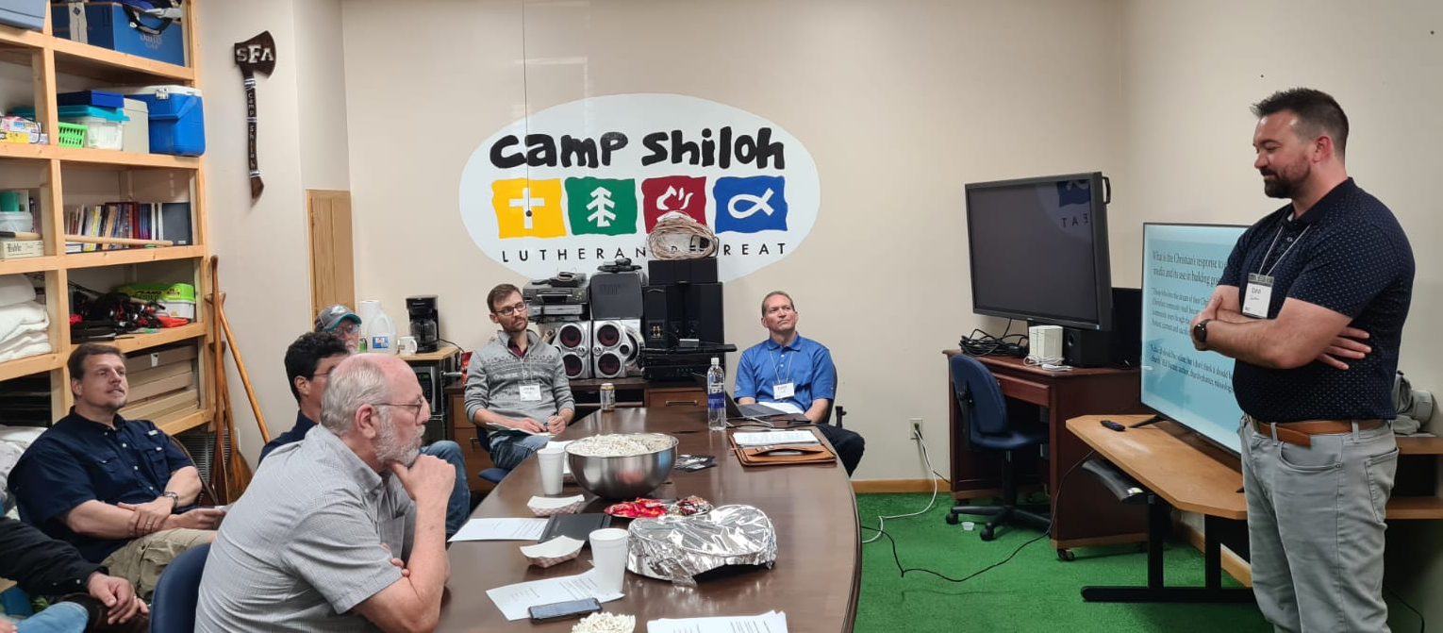
Partnering with One Teams across the globe
Notes:
Pictured: TELL Missionary Dan Laitinen (pictured right) presents at the World Missionary Conference at Camp Shiloh in Pittsburg, Tex., in April 2022 on how to leverage technology for lasting gospel relationships.
Partnering in World Mission fields:
MLP is calling a full-time TELL missionary to live in Africa and follow up with TELL contacts made on the continent.
Four missionaries from Africa teach Bible courses online through the TELL program.
175 students from Africa have enrolled in online TELL courses.
Three self-study audio courses have been translated into Tagalog (spoken in the Philippines) and are now available on the TELL website

Slide 34
Notes:
The 5th annual edition of Faces of Faith will be available online and by request by July 2022. Any congregation is welcome to request up to 50 copies of the magazine, and we are also offering large home and world mission maps (24” x 36”) free of charge. Note – Faces of Faith is automatically sent to any congregation hosting a Mission Festival.
Request your free magazines and maps at wels.net/facesoffaith.

Slide 35
Notes:
WELS Missions Facebook page - Like our page to stay up-to-date on news from Home and World Mission fields, read inspiring stories of the gospel at work, and take advantage of the many resources WELS Missions has to offer.
fb.com/WELSMissions

Slide 36
Notes:
Subscribe to the WELS Missions Update quarterly newsletter and weekly blogs written by our own missionaries here and abroad at wels.net/subscribe.
Missions Blogs:
Sent out every Thursday with personal stories of the gospel at work from our Home, World, and Joint Mission fields
Biannual Missions Update e-Newsletter
Sent out every quarter with the latest news updates from our WELS Home, World, and Joint Missions.
WELS Resource Center:
Find the latest Ministry overviews, PowerPoint presentations, videos, maps, Mission Festival resources, resources for schools, etc. at missions.welsrc.net.
Questions? Email missionspromotions@wels.net

Slide 37
Notes:
Pray. Ask God for more opportunities to reach those who don’t know Jesus Christ as their Savior from sin.
Share. Tell others about the work WELS is doing in the United States and around the world.
Discover. Subscribe to mission blogs at wels.net/subscribe and follow us on Facebook at fb.com/WELSMissions. Learn more at wels.net/missions or e-mail missionspromotions@wels.net with questions.
GIVE – Visit wels.net/give or mail checks with your preferred mission designation (e.g. Home or World Missions) in the memo field to:
WELS, Attn. Gift Processing
N16W23377 Stone Ridge Drive
Waukesha, WI 53188

