Slide 1
Western Wisconsin District Conference
Report of the Synodical Council June 2017

Slide 2
Synodical Council Membership
Synod President as chairman
First and second vice presidents
12 lay members (one from each district)
2 pastors-at-large, 1 teacher-at-large
Chairmen of Home Missions, World Missions, and Ministerial Education
3 Conference of Presidents members
10 advisory members
Notes:
The Synodical Council Membership consists of the following members. Synod President, the Synod First and Second Vice Presidents, a lay member from each of the 12 districts, 2 pastors at large, 1 teacher at large, the chairman of the Home and World Missions and Ministerial Education, 3 pastors from the Conference of Presidents and 10 advisory members

Slide 3
Synodical Council Structure
Three primary committees: Administration, Ministry, and Finance
Two standing sub-committees: Compensation Review and Capital Projects
Two special groups report to the SC: Accounting Oversight Committee (p.88) & the Human Resources Advisory Committee (p.96)
Notes:
The Synodical Council has Three primary committees….Administration, Ministry and Finance. The Administration Committee is responsible for developing and implementing general policies and procedures. They also provide oversight of the synod’s subsidiaries the departments of Human Resources, Technology, Communications and the Ministry of Christian Giving. The Ministry Committee oversees and coordinates the plans and activities of all areas of ministry and works to monitor and evaluate how the various areas of ministry are carrying out their tasks in keeping with the synod’s long-range ministry plan. The Finance Committee is responsible for establishing the support forecast and for recommending the overall level of spending for budgetary planning. Working closely with the synod’s Chief Financial Officer, the committee oversees the risk management, banking, and general financial situation of the synod. There are currently two standing sub-committees…Compensation Review and Capital Projects. As well as two special groups...You can read The Accounting Oversight Committee’s report beginning on page 88 of the Book of Reports and Memorials and the Human Resources Advisory Committee report on page 96.

Slide 4
Synodical Council Duties
“The Synodical Council is responsible for the implementation of all decisions and resolutions made by the synod in convention and for overseeing all activities of the synod in pursuit of its mission (other than those that are the specific responsibility of the Conference of Presidents” (pp.77-81)

Slide 5
2017-2025 Long-Range Plan
“Our Great Heritage” To be adopted in 2017, looking toward 2025 – the 175th anniversary of the synod (pp.82-86)
The SC oversees areas of ministry and departments as they develop strategies
The SC receives regular progress reports from the areas of ministry and departments
The SC evaluates the ministry plans and then allocates funds for programs and services in the Ministry Financial Plan

Slide 6
Capital Projects Committee
Formed by 2013 convention resolution
Identifies funding strategies
Little deferred maintenance but renovations needed
FY 2017-18 $1.7M funded; $140k unfunded
FY 2018-19 $1.7M funded; $499k unfunded
Beyond – ???
Notes:
The 2013 convention called for the formation of the Capital Projects Committee recognizing the need to plan for the maintenance and updates of existing facilities. The committee also coordinates future land and facility needs as well as options for funding those needs. Overall, WELS facilities have been keep in good repair, even through challenging financial times. However, maintenance efforts have not been level across the ministerial education schools. WLS and MLC, with their stronger financial positions, have be able to do more maintenance and improvement project. Whereas LPS and MLS have accomplished projects through special gifts and if surpluses are realized.
The ministry financial plan for both years of the biennium include $1.7 million for capital projects with some of the identified projects not yet funded. Also, significant expansion of facilities at some of the schools are currently being vetted. It is too early to project the outcome of the vetting process but significant resources will need to be raised if the projects are approved as a ministry need and are approved by the Conference of Presidents for funding.

Slide 7
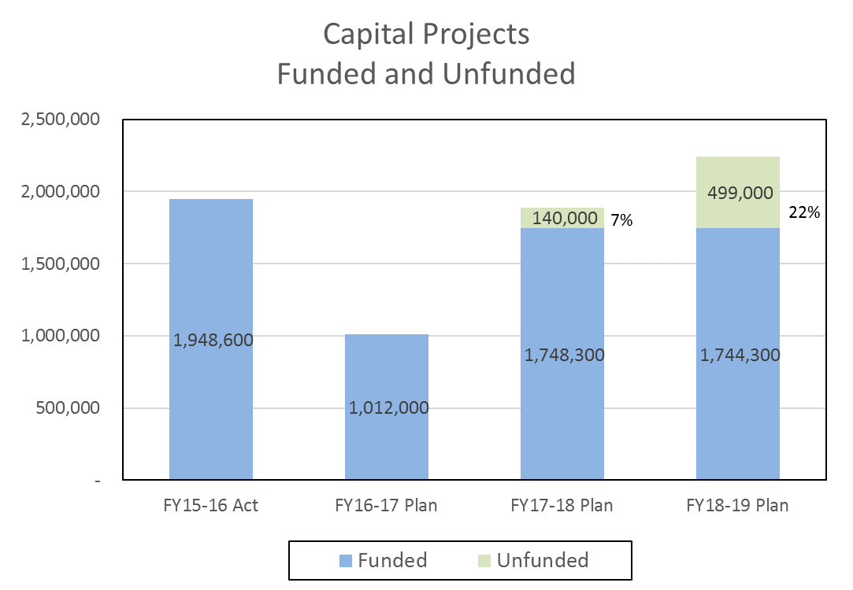
Capital Projects Committee
Notes:
Looking back and looking ahead, a significant amount of resources has been used or planned for capital projects. In FY 2015-16, nearly $1,950,000 was spent on capital projects including refurbishing the LPS chapel and organ. In the year that is coming to a close, FY 2016-17, expenditures are planned at about $1,000,000; however, if schools financial results are better than planned, those funds may be used for unfunded projects that are scheduled for completion in the upcoming biennium. You may read the Capitol Projects Committee’s full report beginning on page 98 of the Book of Reports and Memorials.

Slide 8
Ministry Financial Plan Highlights
Synod remains financially sound
Debt was retired
Proposed plan is balanced
Financial Stabilization Fund working as intended
Small increase in synod support
Use of reserves
Congregation Mission Offerings (CMO) remain the primary source of synod support
Includes 3 subsidiaries – CEF, WIF, and WELS Foundation
Notes:
The ministry financial plan, or budget as it used to be known, is fiscally responsible and balanced as it does not exceed available resources. As you have likely already heard, WELS retired its remaining debt in December of 2016. The debt, which stood at $22.4 million in 2008, was retired about 18 months early through the Synodical Council’s annual commitment to debt servicing through annual support allocations of $1.6 million and gifts from members like you and the congregations you represent. Praise God for removing this financial burden!
Planned synod support increased slightly over the current biennium primarily to honor commitments and fund the Director of Discipleship and an additional Christian Giving counselor in the second year of the biennium. Synod support includes congregation mission offerings or CMO and transfers from the financial stabilization fund or FSF. The financial stabilization fund was created by the synodical council in 2009 and holds gifts, grants, bequests and other unrestricted support until the year after it is received before deploying it to fund ministry programs. The Lord has also blessed this initiative. As a result, what used to be frequent mid-year or mid-biennium modifications of the ministry plan have been averted.
While the plan is balanced the planned expenditures for ministry are greater than the forecasted inflow of support, so reserves, in the financial stabilization fund, ministry special funds and schools are planned to be reduced by nearly $13 million during the biennium. Much of the planned use of reserves is a result of relatively flat CMO over the last ten years which has historically been the primary source of synod support.
New this biennium is the inclusion of the Church Extension Fund (CEF), WELS Investment Fund (WIF) and WELS Foundation in the ministry financial plan. These self supporting entities are now included to further enhance the scope of programs and support included in WELS long range and strategic planning.

Slide 9
Notes:
Congregation mission offerings or CMO have been relatively flat for the last ten years while ministry costs have continued to increased. The plan assumes that CMO will increase one-half of one percent annually based on actual results from the last five years. If congregation mission offerings had grown at the general inflation rate of 3 percent since 2008, about $8 million more would be available to address ministry needs in our educational programs and for outreach at home and abroad. As a result… areas of ministry, like Home and World Missions and the four ministerial education schools have looked to special gifts and tuition increases to maintain and grow their ministries which are generally less predictable and many times inconsistent.

Slide 10
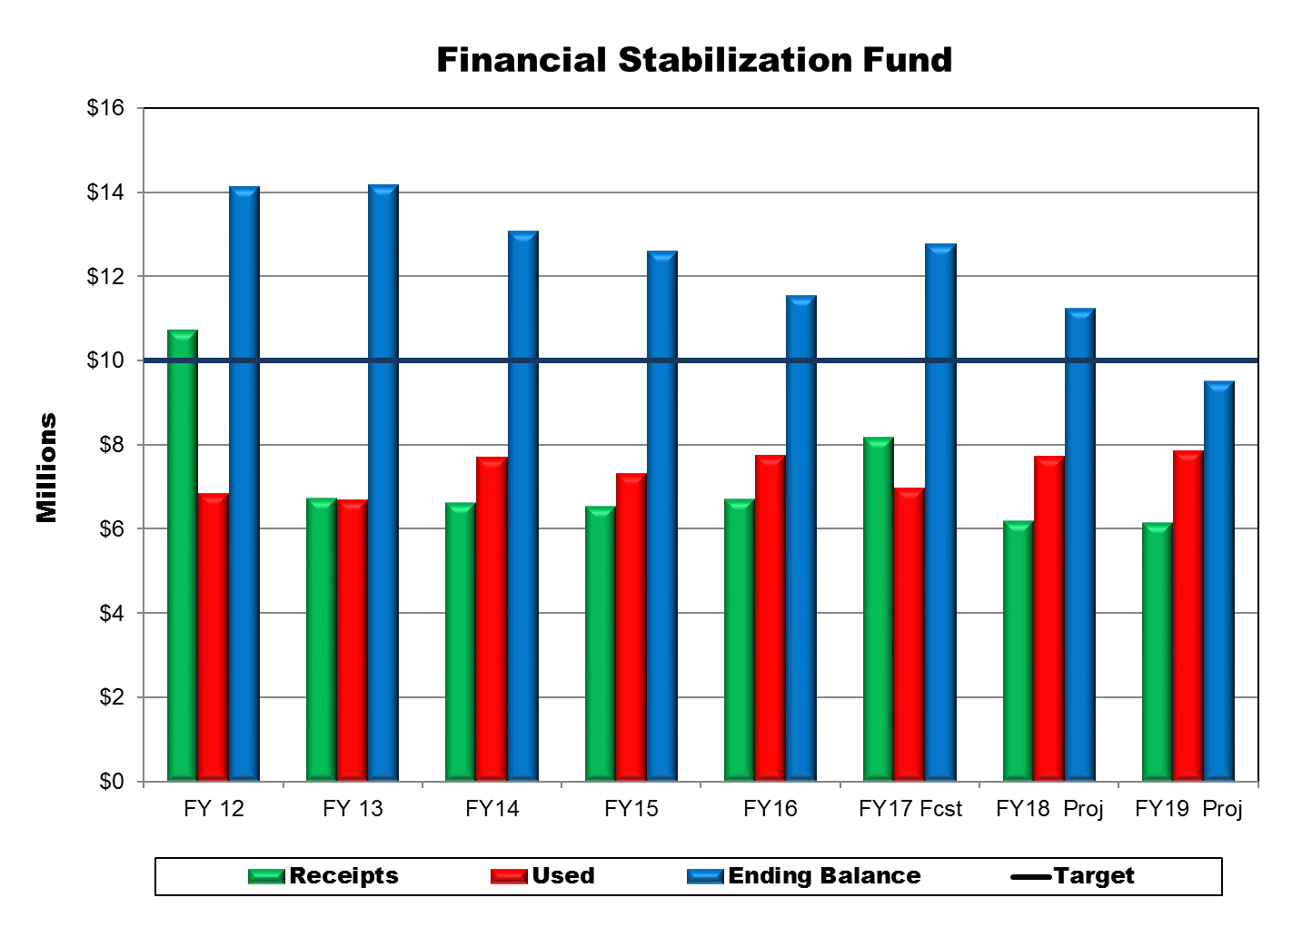
Notes:
As mentioned previously, the financial stabilization fund was created to hold somewhat unpredictable sources of support for ministry uses the year or years after it was received. The fund has worked as planned so mid-year adjustments to ministry programs have not been needed.
The balance in the fund since its creation has been kept at a healthy level but recent trends reflect a reduction in receipts and an increase in uses going back to FY14 with the exception of FY17. There is an increase projected for FY17 due to a couple of one-time events that include the designation of $1.1 million of unrestricted reserves and the proceeds from the sale of a closed Virginia congregation facilities.
In conjunction with development of the ministry financial plan, the Synodical Council set a minimum target level for the fund of $10 million. The proposed plan for the biennium draws down the reserves of the fund by nearly $3,250,000 for a projected ending balance $9,500,00 which is below the target minimum. This level of draw down in the fund is not sustainable and if projections are proved to be correct, significant reductions in ministry could be necessary in the following biennium. While this projection may sound dire, our gracious Lord has consistently blessed WELS with more resources or lower costs. The Synodical Council will be closely monitoring the fund and will use whatever new information is available when planning for the 2019-2021 biennium. That planning begins one year from now.

Slide 11
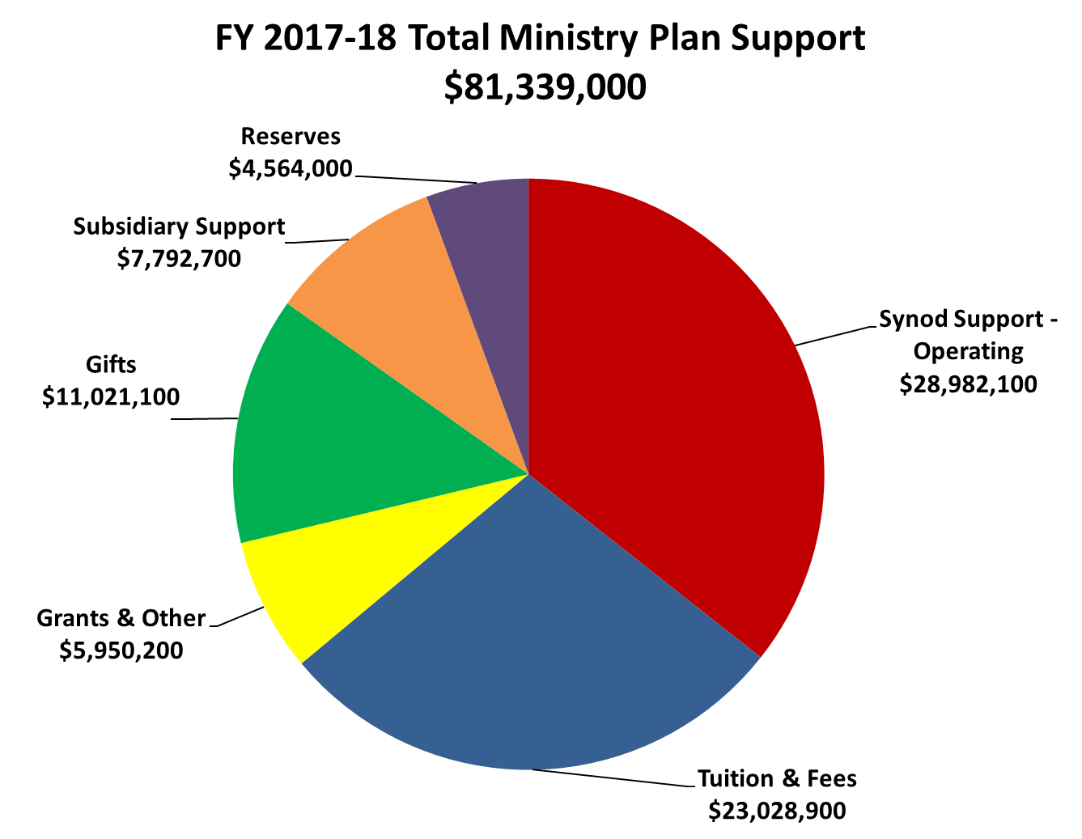
Notes:
The proposed plan for fiscal year 2017-18 is based on support of $81,339,000. The synod support from CMO and the FSF totals $28,982,100 or 36% of the total. Tuition and fees from schools and programs like the international youth rally and the convention are the second largest source at $23,028,900 or 28%. Gifts and bequests of $11,021,100 provide 14% of planned support. Subsidiary Support of $7,792,700 provide 10% of total support. Grants and reserves provide the balance of funding for the plan.
Synod support – operating: Includes CMO and transfers from the financial stabilization fund
Tuition & Fees: Includes ministerial education as well as from programs like the international youth rally and to Lutheran Schools
Grants and Other: Includes Vicar program funding from WLS, the CEF grant, the grant for Grenada, PSI funding from JMC, endowment distributions, schools satisfactions of restrictions.
Gifts: Includes gifts and bequests from individuals
Subsidiary Support: Includes revenues, fees and interest income
Reserves: Includes the special funds of areas of ministry and the schools

Slide 12
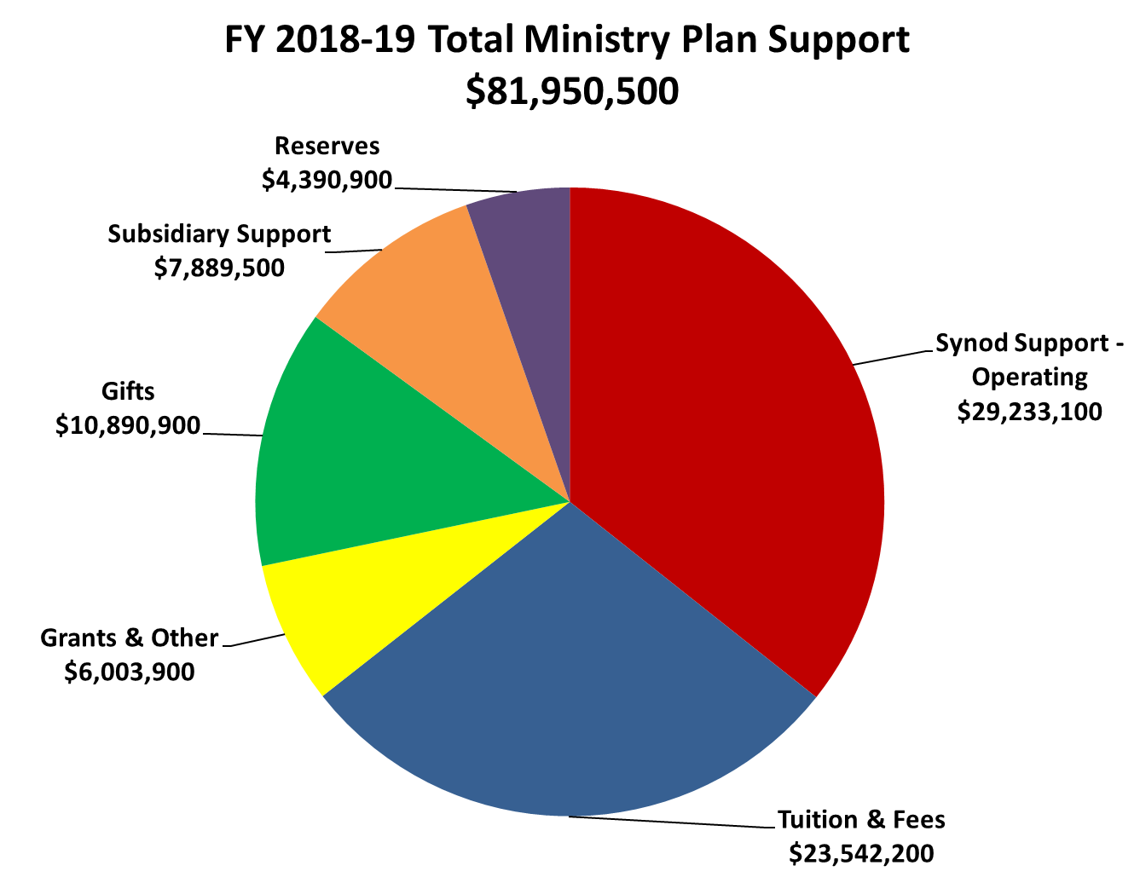
Notes:
The proposed plan for fiscal year 2018-19 is based on support of $81,950,500. The synod support from Congregation Mission Offerings and the Financial Stabilization Fund totals $29,233,100 or 36% of the total. Tuition and fees from schools and programs like the international youth rally and the convention are the second largest source at $23,542,200 or 29%. Gifts and bequests of $10,890,900 provide 13% of planned support. Subsidiary Support of $7,889,500 provide 10% of total support. Grants and reserves provide the balance of funding for the plan.
Notes:
Synod support – operating: Includes CMO and transfers from the financial stabilization fund
Tuition & Fees: Includes ministerial education as well as from programs like the international youth rally and to Lutheran Schools
Grants and Other: Includes Vicar program funding from WLS, the CEF grant, the grant for Grenada, Pastoral Studies Institute funding from the Joint Mission Council endowment distributions, schools satisfactions of restrictions.
Gifts: Includes gifts and bequests from individuals
Subsidiary Support: Includes revenues, fees and interest income
Reserves: Includes the special funds of areas of ministry and the schools

Slide 13
Ministry Plan Financial Highlights
Martin Luther College (p.176)
Luther Preparatory School (p. 187)
Michigan Lutheran Seminary (p. 192)
Wisconsin Lutheran Seminary (p. 168)
World Missions (p. 154)
Home Missions (p. 147)
Congregation and Ministry Support Group (p. 44)
Notes:
The Lord has presented us with many exciting mission and ministry opportunities which are included in the reports from our Ministerial Schools, World and Home Missions and the Congregation & Ministry Support Group. You will hear these reports during this meeting from the areas of ministry or you can read their reports, on the pages indicated in the Book of Reports and Memorials. I also encourage you to read the entire Synodical Council report which begins on page 77 of the BORAM.

Slide 14
64th Biennial Convention of the
Wisconsin Evangelical Lutheran Synod
July 31 – Aug. 3, 2017
Notes:
Thank you for your time and attention. I will now answer any questions you may have.

