Slide 1
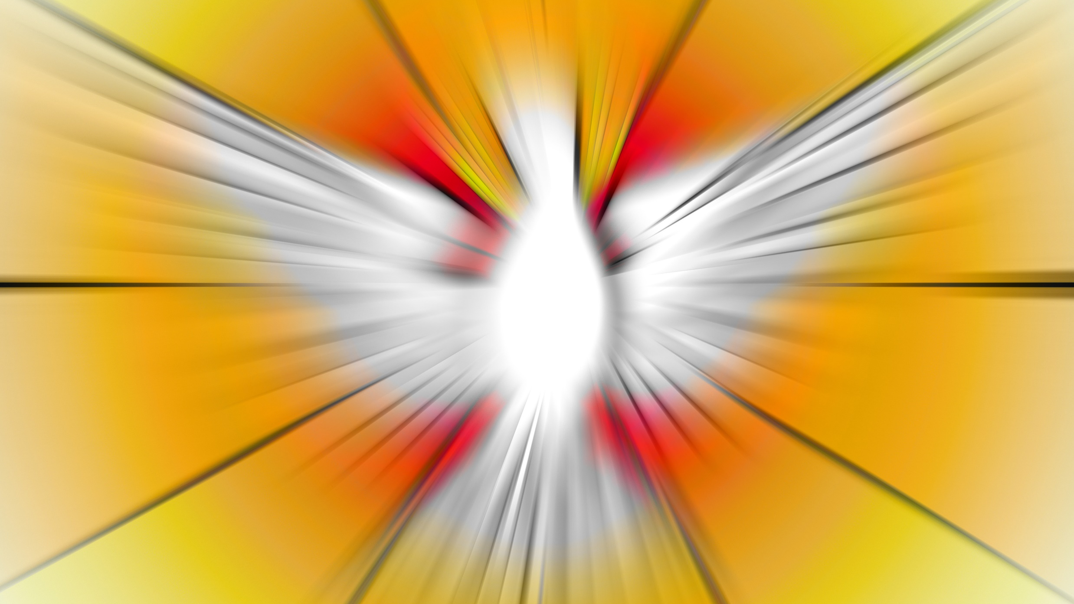
“You will be my witnesses in Jerusalem, in all Judea and Samaria, and to the ends of the earth.” Acts 1:8

Slide 2
Western Wisconsin District Mission Board
Pastor Jeffery Mahnke (Chairman)
- St Peter’s, Schofield
John Deglow
- St Mark’s, Watertown
Ron Demulling
- St John’s, Cornell
Pastor Paul Schupmann
- St John’s, Juneau

Slide 3
Missions Being Highlighted Today
1 Adams, WI – St. Paul’s
2 Richland Center, WI
3 Stevens Point, WI – The Word
4 Mt. Horeb, WI – Good News
5 Roscoe, IL - Amazing Grace
6 Horicon, WI- St. John’s
7 Burlington, IA – Our Savior

Slide 4
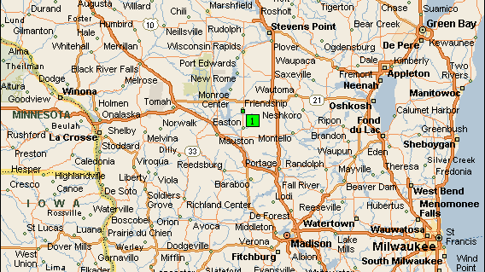
St. Paul’s Ev. Lutheran Church
Adams, WI

Slide 5
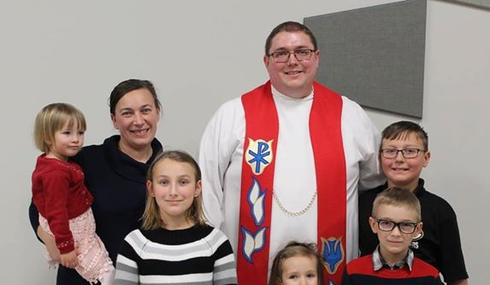
PASTOR JASPER SELLNOW
Pastor Sellnow was installed at St. Paul's Lutheran Church in January of 2018.

Slide 6
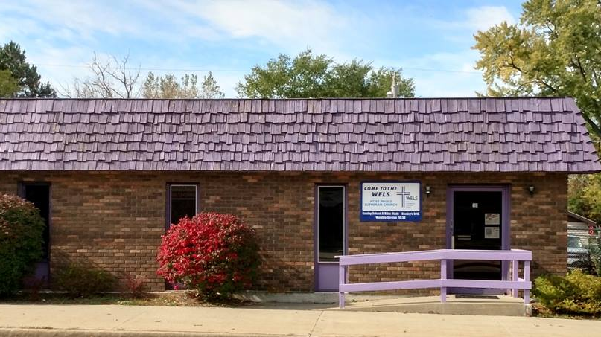

Slide 7
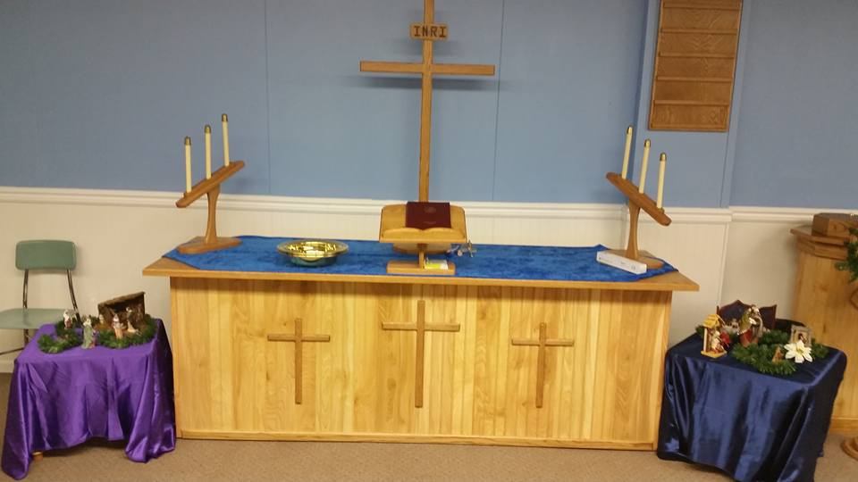

Slide 8
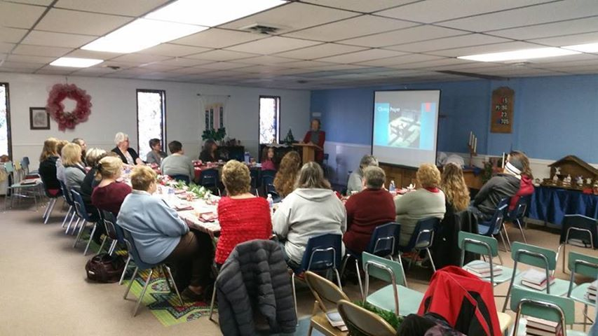

Slide 9
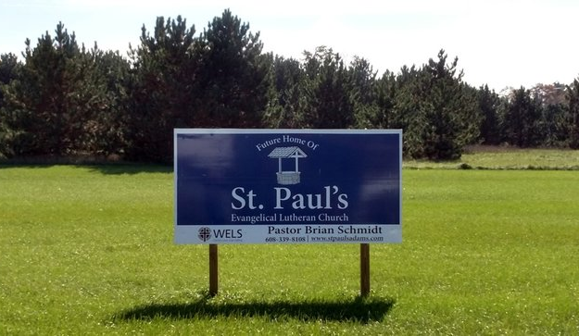
ADAMS NEW CHURCH BUILDING PROJECT
St. Paul's has purchased land across from the Adams County Fairgrounds in Friendship to build a new church building. St. Paul’s is looking at breaking ground in 2019 or 2020.

Slide 10
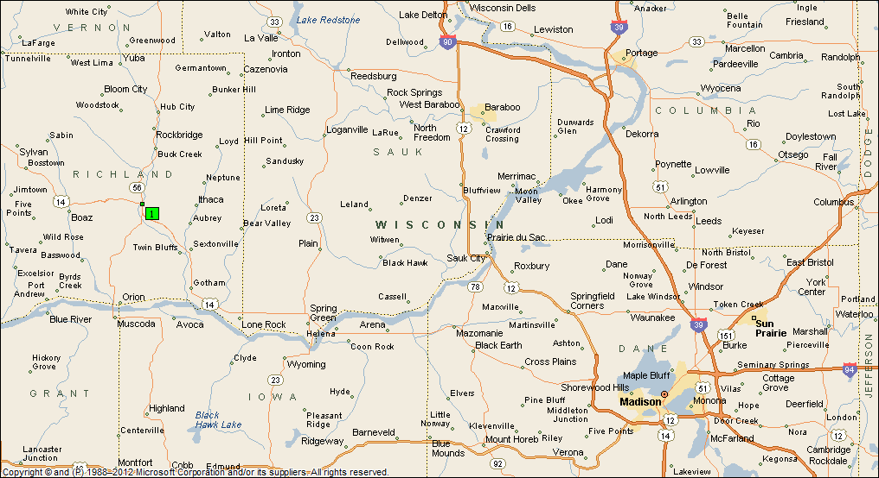
Richland Center, WI

Slide 11
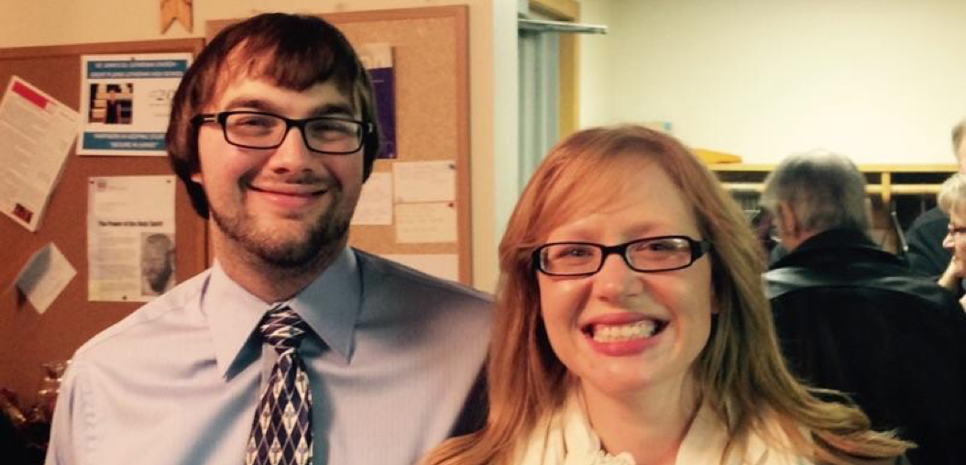
Pastor Daniel Lewig and wife Amanda…installed Dec 2015

Slide 12
Dual Parish Stats Not large congregations or budgets
St John's - Hillpoint Avg Sunday attendance: 55
Yearly budget:
$65,000
Trinity - Lime Ridge Avg Sunday attendance: 30
Yearly budget:
$25,000

Slide 13
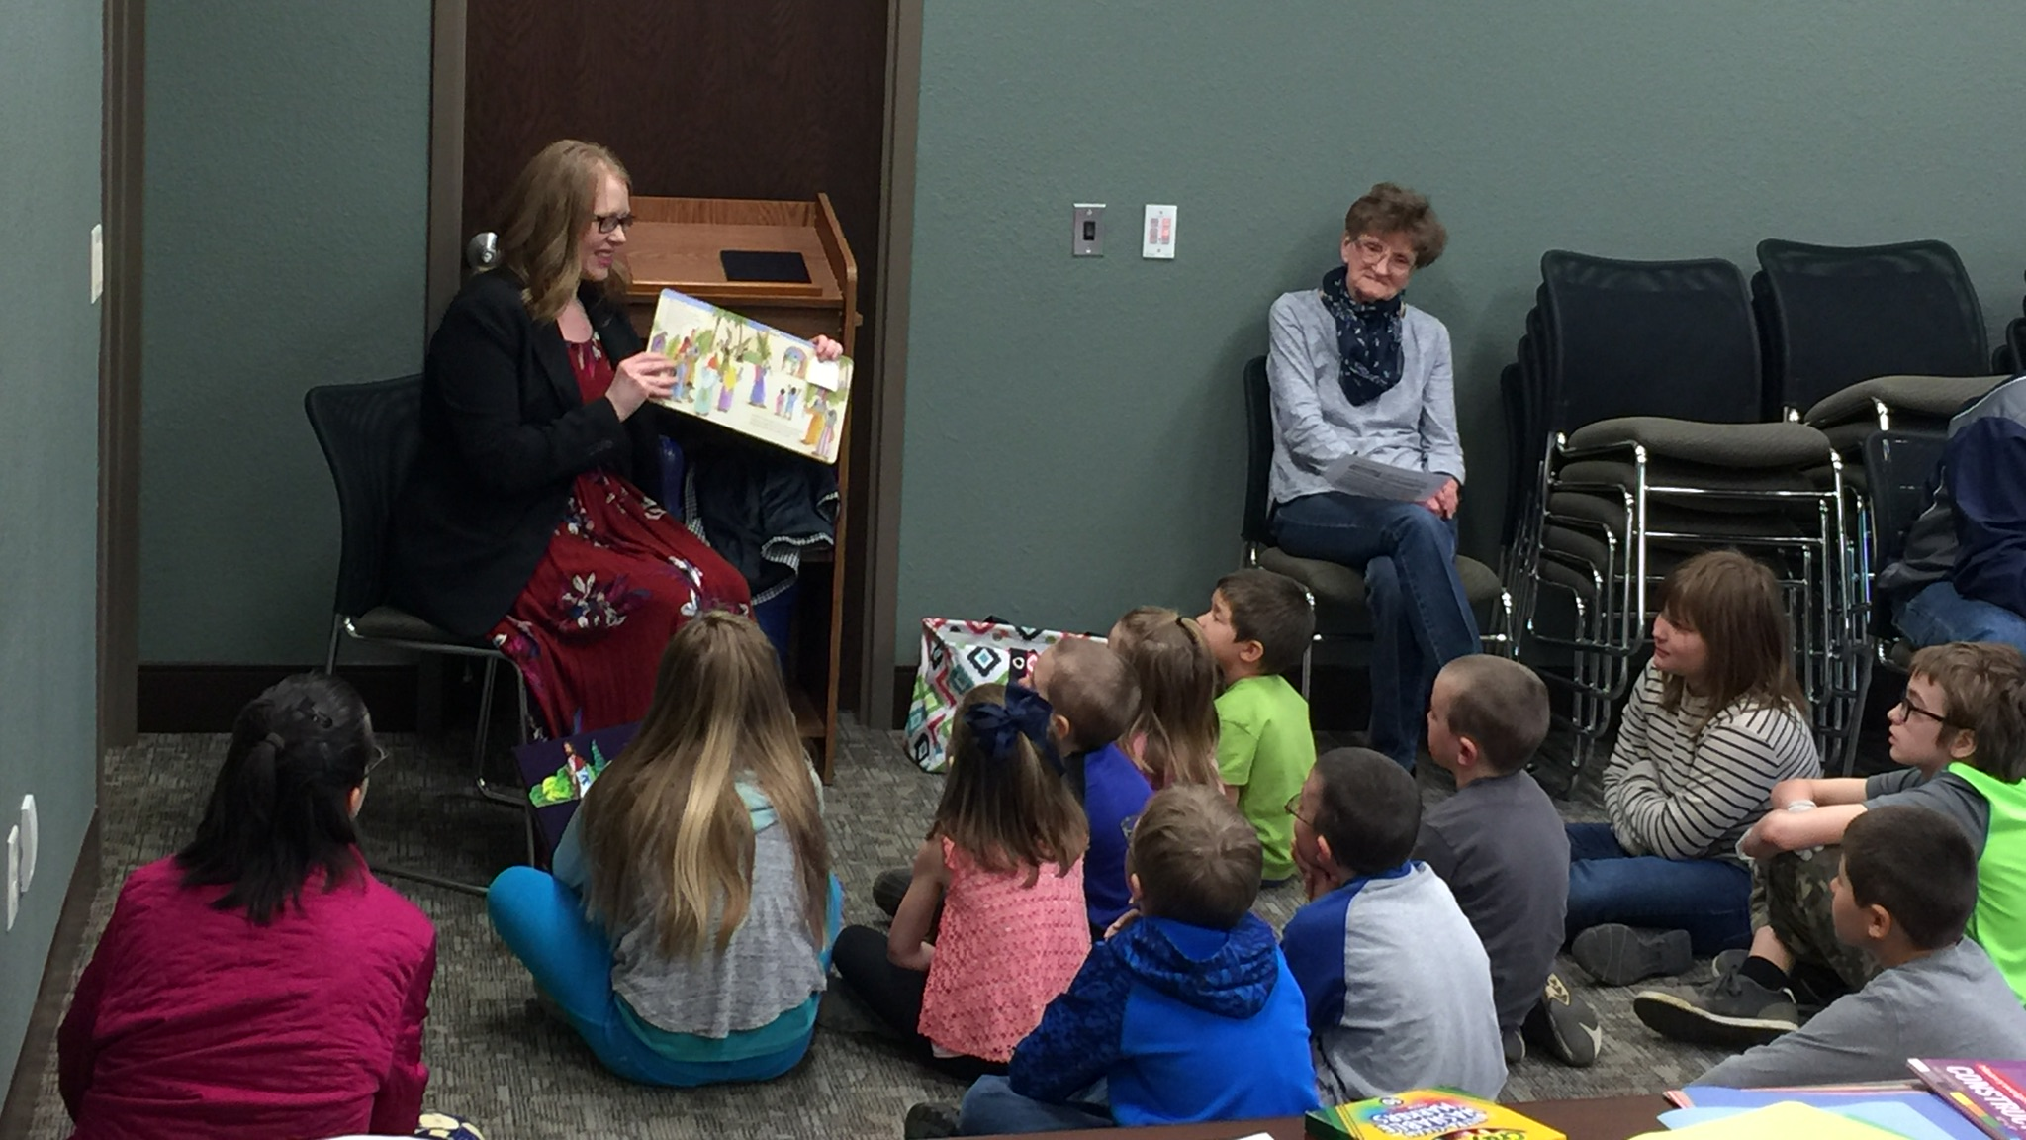
Easter For Kids 2018
(3rd year hosting event--gone from 25 to 40 to 65 children...counting parents, 100 people in attendance this year, 2/3 do not have church homes)

Slide 14
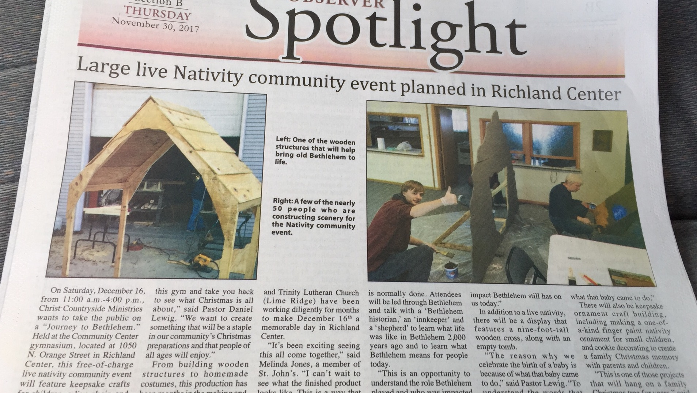

Slide 15
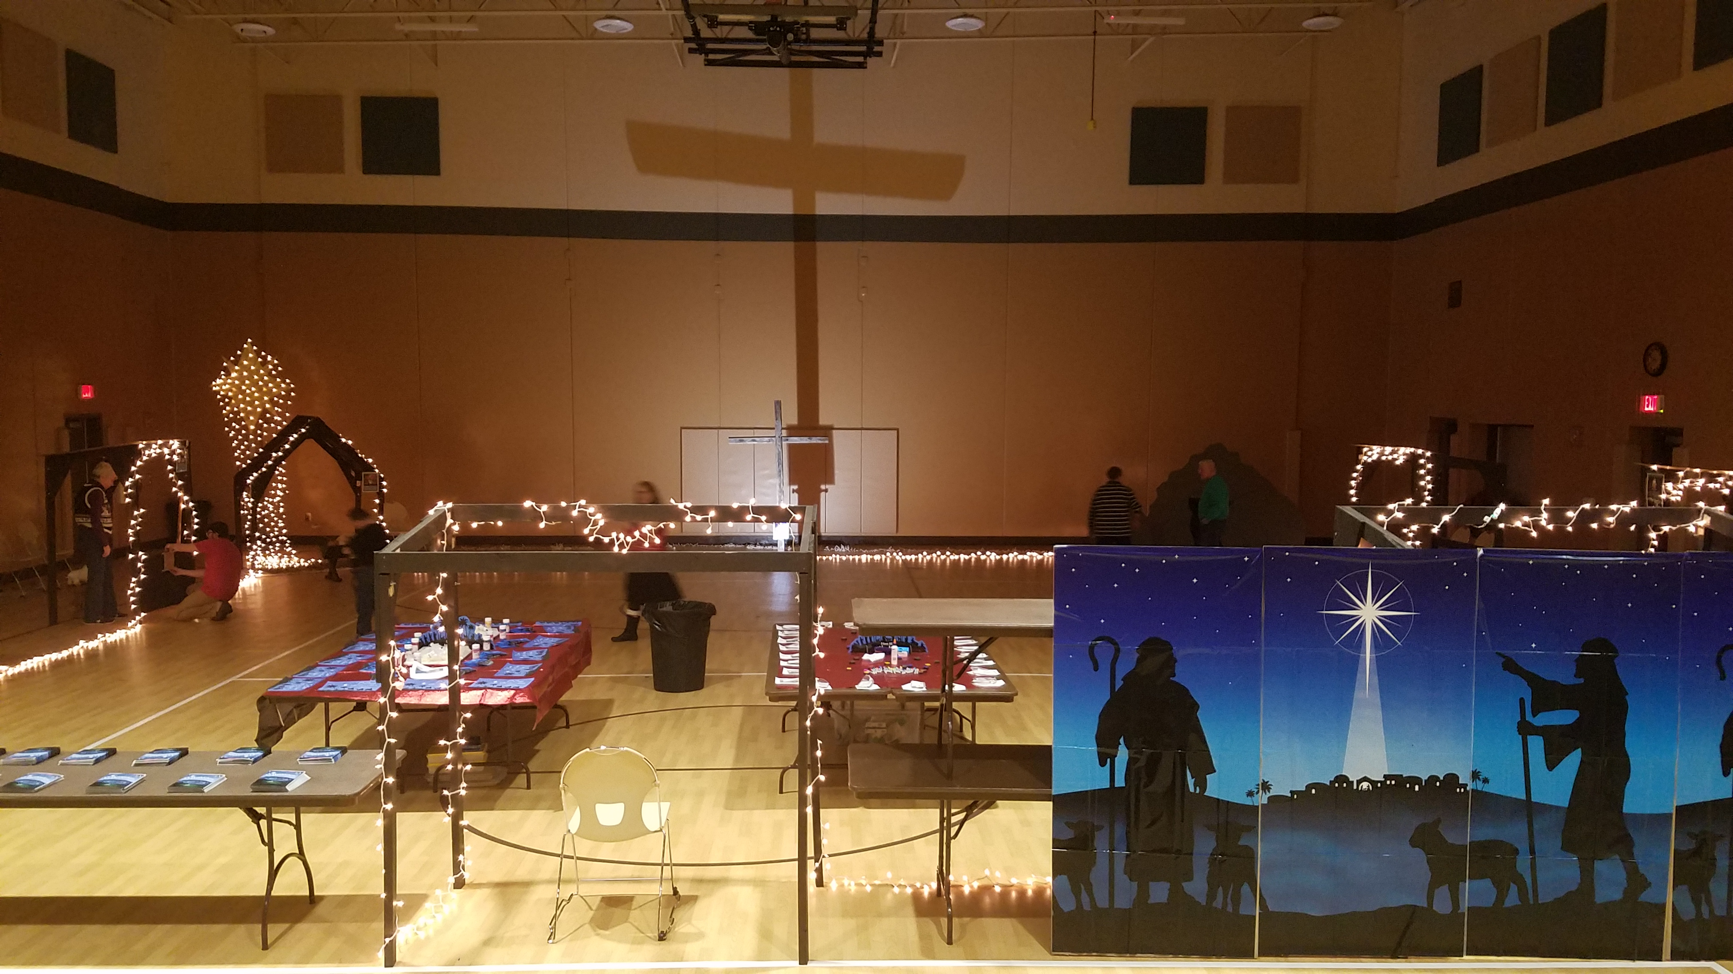
400 people attended event, including
75 new prospects!)

Slide 16
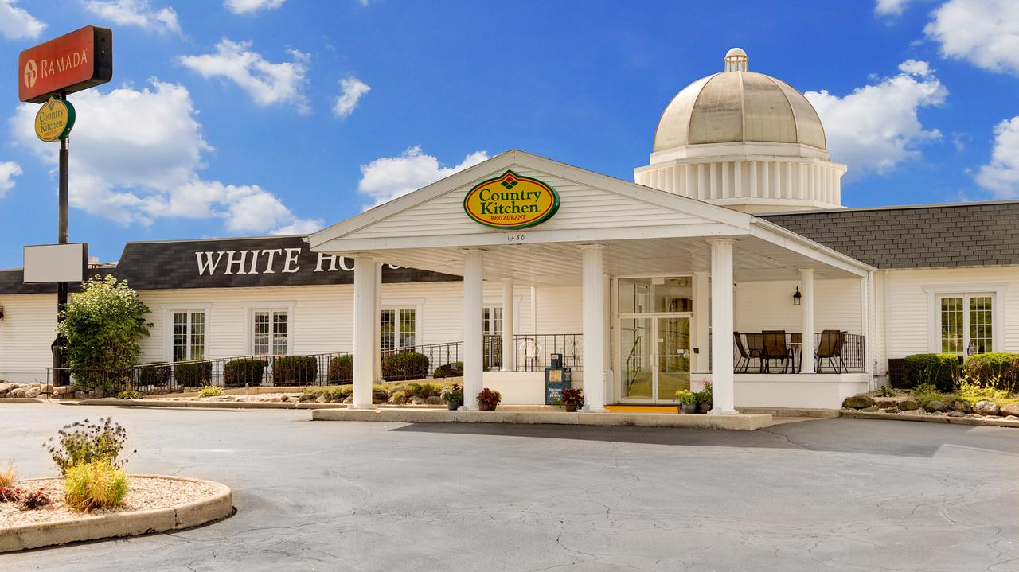
(5-10 members attend Bible Class here, as well as 3 prospects)

Slide 17
Upcoming Ministry Plans – Pray For Us!
Hosting week-long STEM Camp in July
Starting a Mornings With Mommy program in Fall
Requesting subsidized mission status to start worship services in Fall of 2019

Slide 19
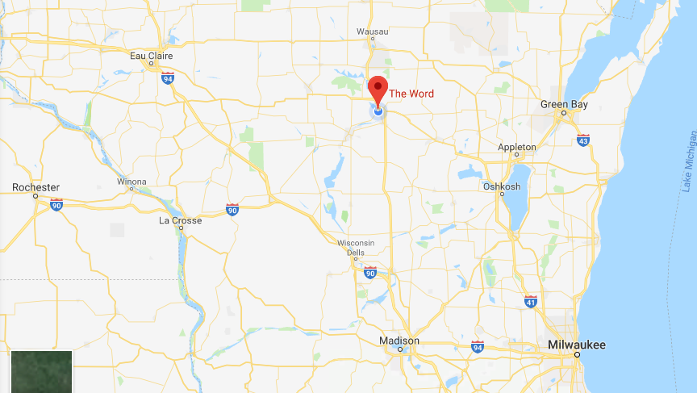

Slide 20
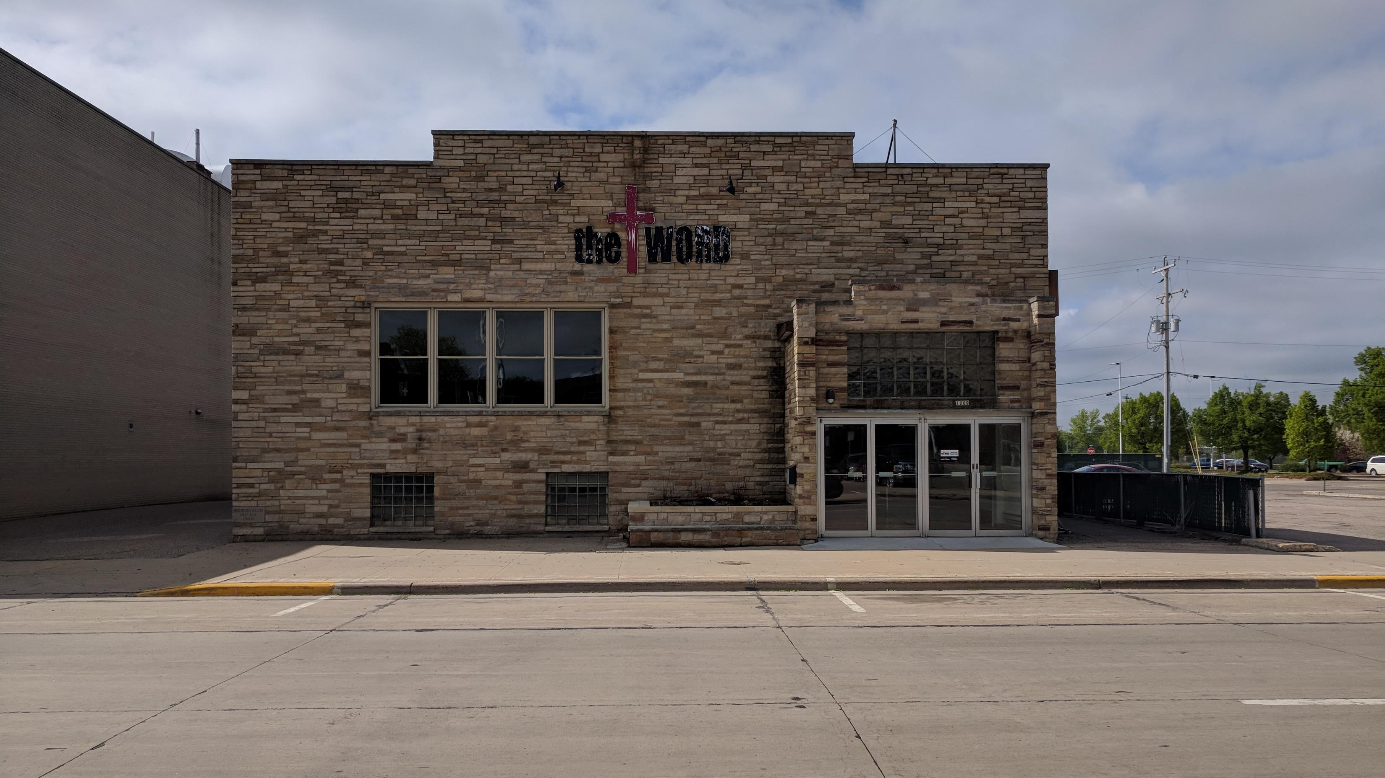

Slide 21
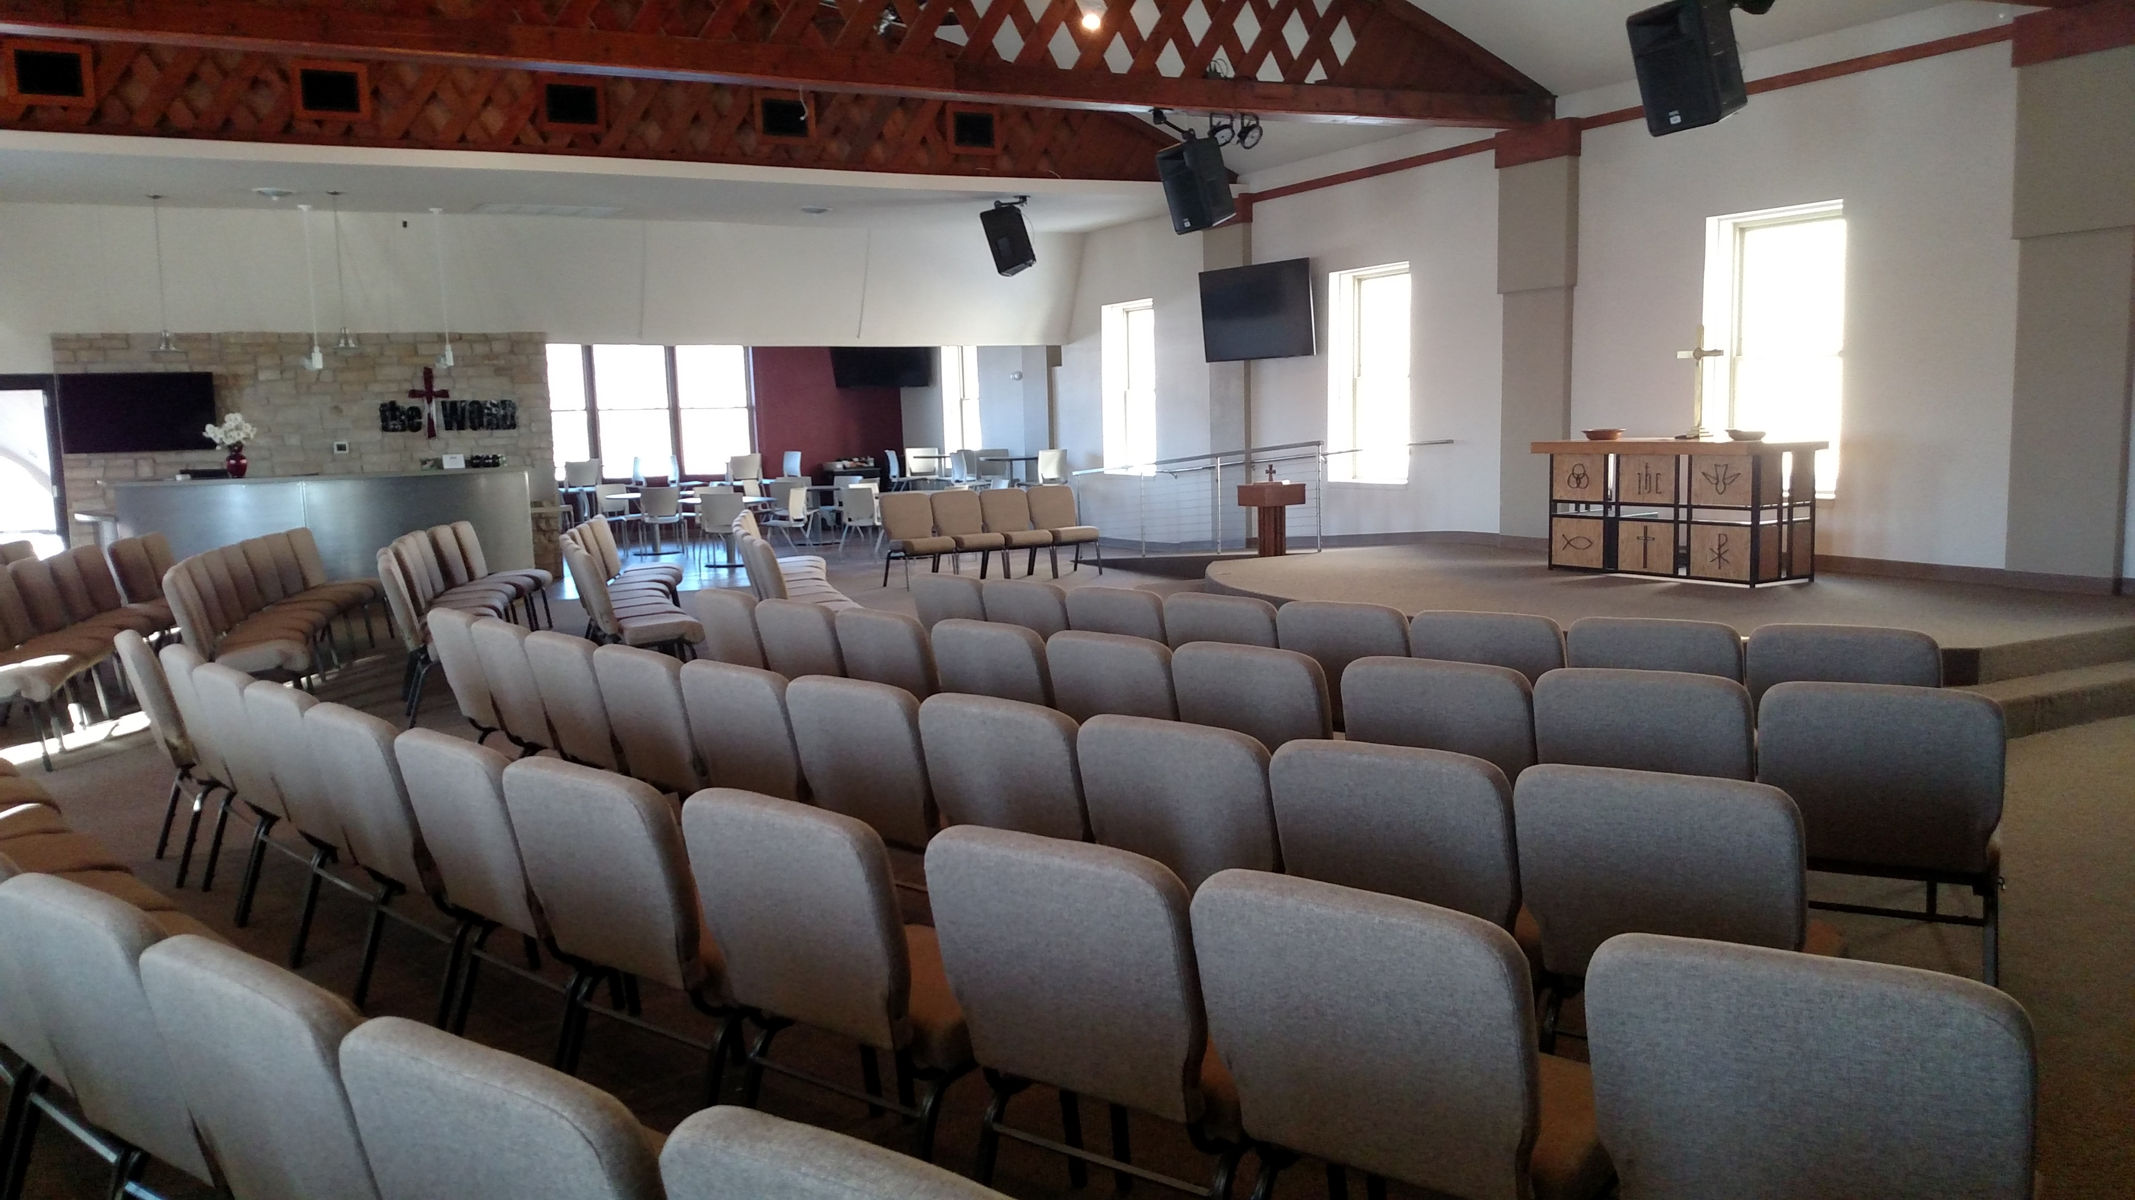

Slide 22
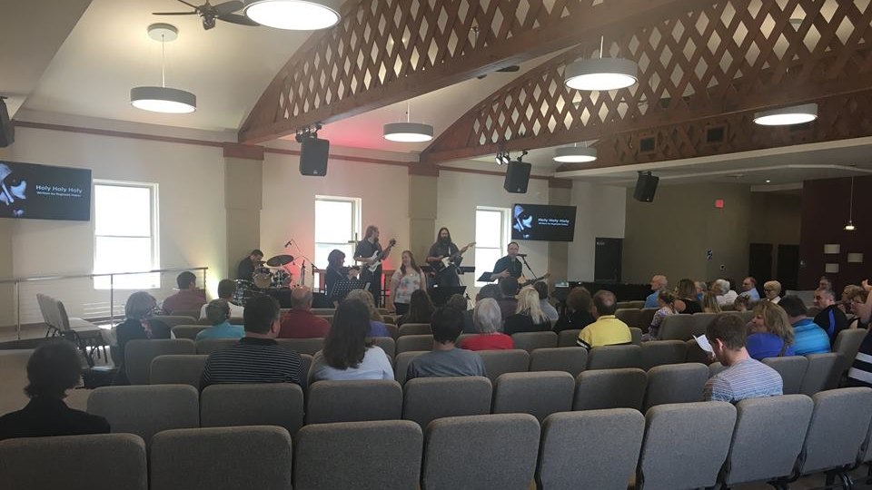

Slide 23
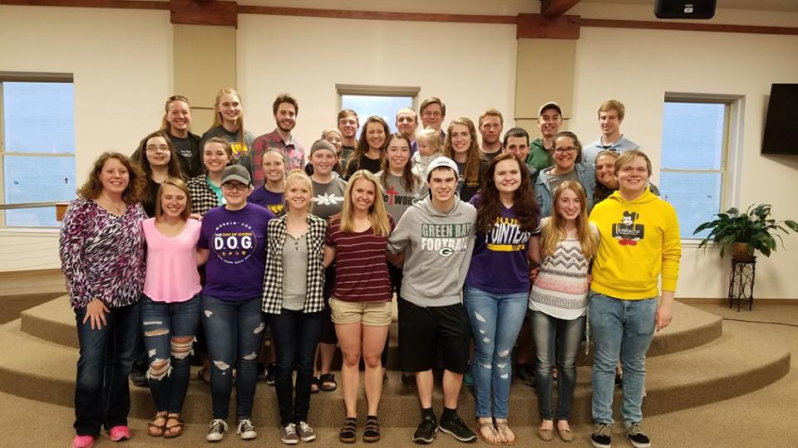

Slide 24
Good News Lutheran, Mt. Horeb, WI

Slide 26
Good News was started by members of Resurrection in Verona.
Initial conversations and planning began in 2012.
Other milestones in our young church's history include:
July 14, 2013 - First Sunday service held (pictured above)
September 15, 2013 - Official grand opening for the community

Slide 27
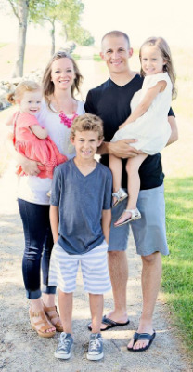
On July 13, 2014, Pastor Jonathan Bauer was installed as the first full-time pastor at Good News Lutheran Church.

Slide 28
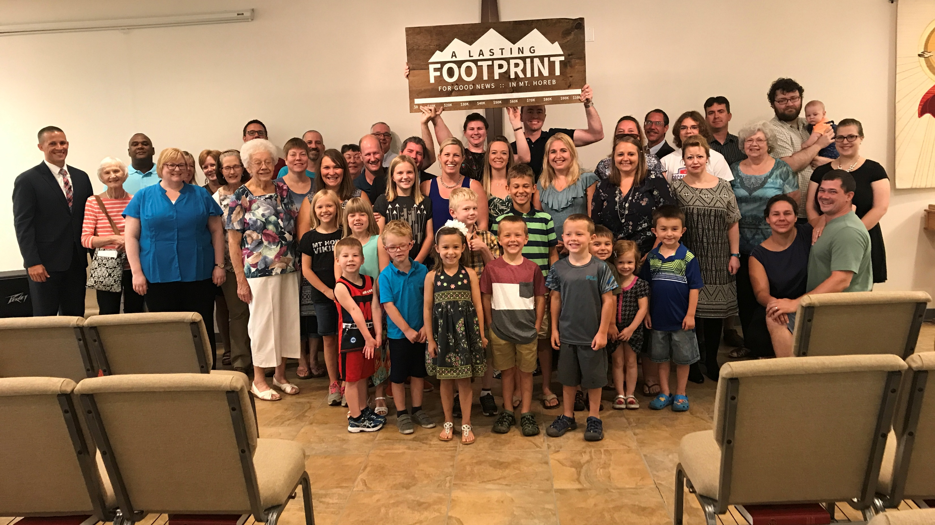

Slide 29
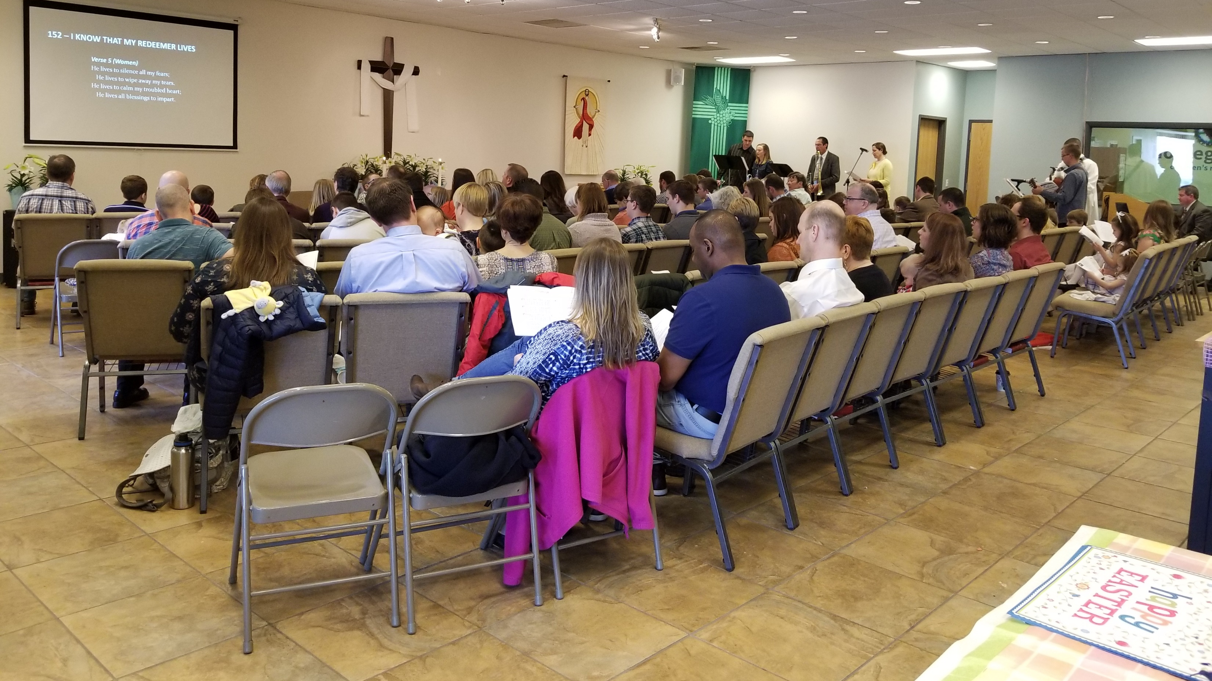

Slide 30
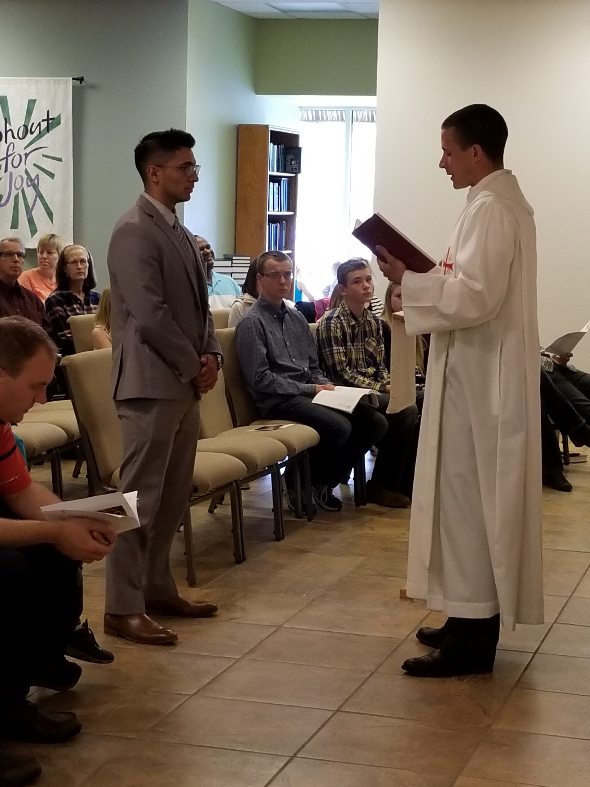
Summer Vicar
Isaac Hayes being installed.
5/27/2018

Slide 32
2020 VISION: MAKING MT. HOREB HOME
Only God can see what Good News Lutheran Church will look like three to five years from now. Only God’s power and God’s blessing can make any plans or dreams a reality.

Slide 33
2020 VISION: MAKING MT. HOREB HOME
1. MAKE ROOM AT OUR TABLE
2. OPEN DOORS TO OUR COMMUNITY
3. DISCOVER THE STRENGTH OF OUR FOUNDATION
4. BUILD A HOUSE FOR OUR FUTURE

Slide 34
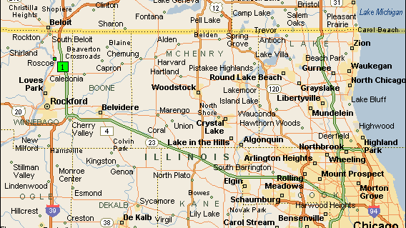
Amazing Grace, Roscoe, IL

Slide 35
Pastor Burow
What a Stud…

Slide 37
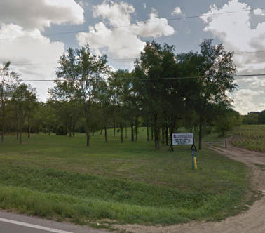
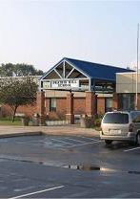

Slide 38
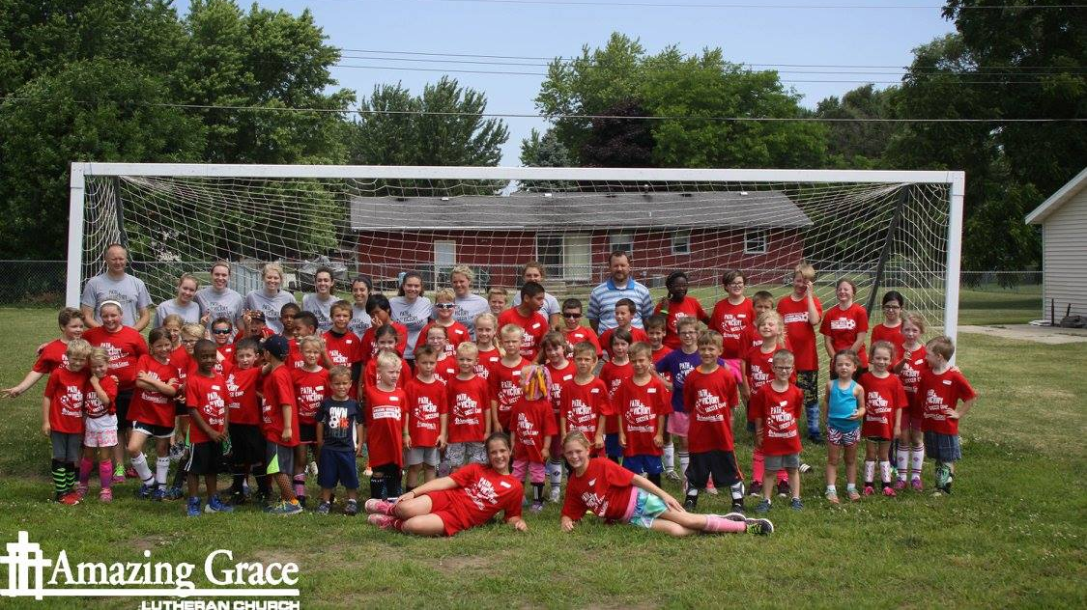

Slide 39
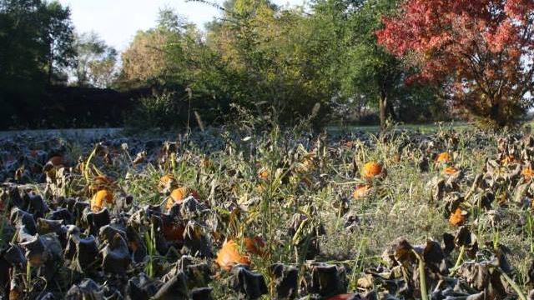

Slide 40
St. John’s, Horicon, WI

Slide 41
Summary of Steps Taken…
Talked to Pastors and Churches that have done Multi-Site
Attended a Multi-Site Conference (Tuscon, AZ)
Looked at our surrounding community with fresh eyes
Formed a Second-Site Committee
Worked with DMB / Mission Counselor Pastor Mark Birkholz
( Minimum 1 year)
Filled out the Eight Questions (DMB / BHM Provides)
Lots of Communication with St. John’s

Slide 42
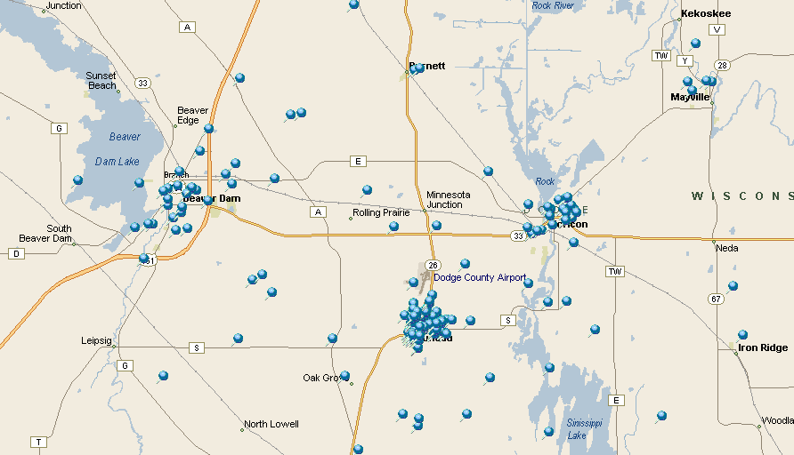

Slide 44
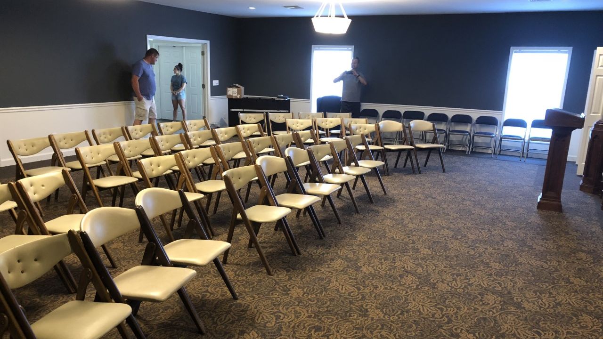

Slide 45
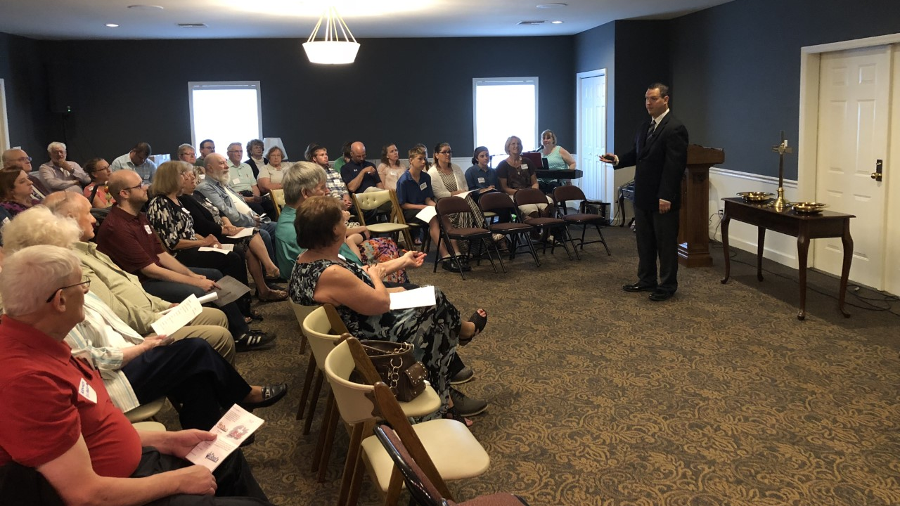

Slide 46
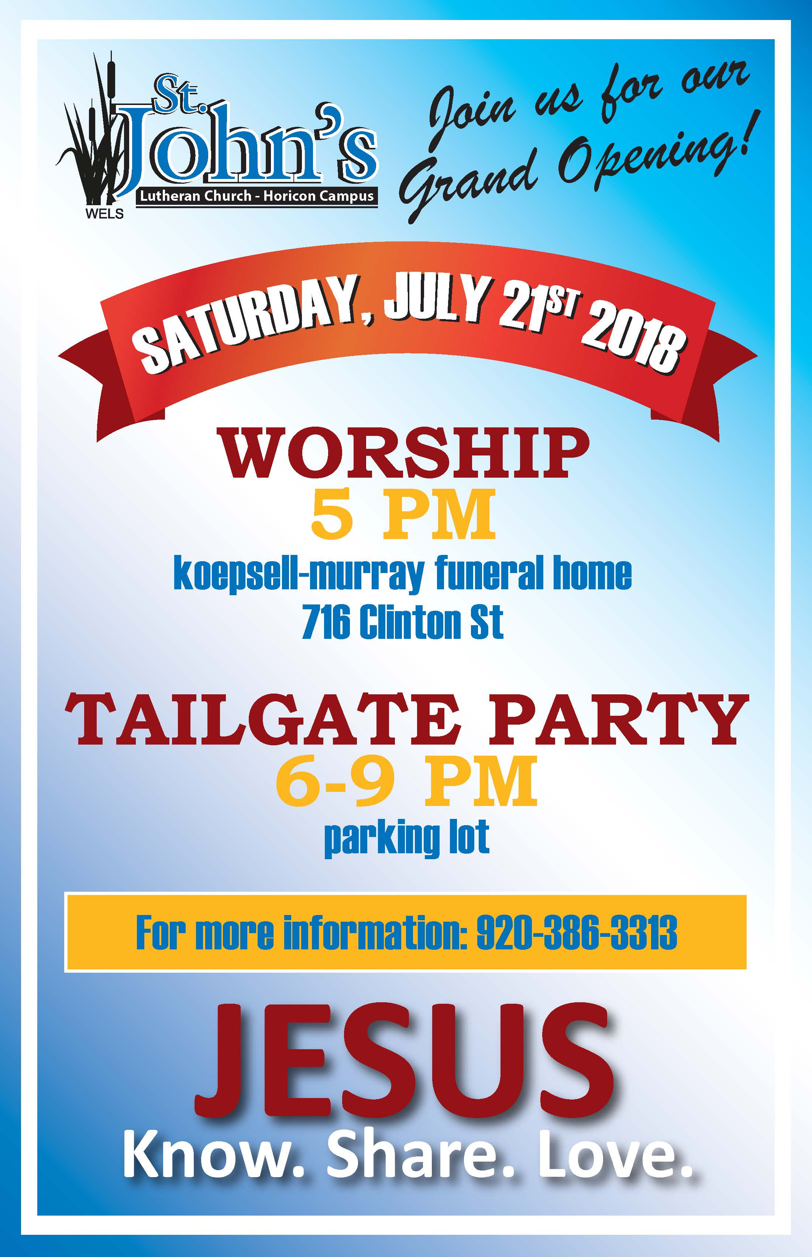

Slide 47
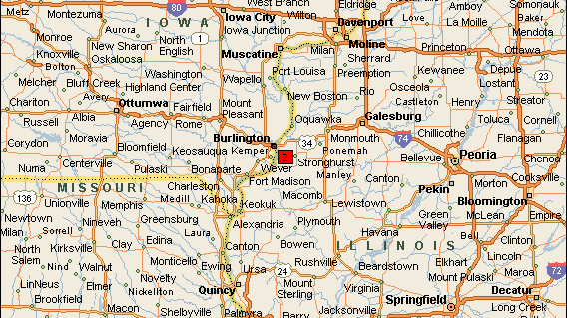
Our Savior Lutheran Church
Burlington, Iowa

Slide 48
Our Savior Ev. Lutheran Church
Divine Service | Sunday 2:30 p
Our Savior has been gathering around Christ and His Word and Sacraments since 1974. The souls of Our Savior are served by Lutheran pastors from the Quad Cities.
Vacancy Pastor The Rev. Matt Mueller Guest Preacher The Rev. Luke Boehringer

Slide 50
